Slide 1
uMove
Luddy School of Informatics, Computing and Engineering
INDIANA UNIVERSITY BLOOMINGTON
1
Notes:
AJ

Slide 2
Overview
Team Introduction
Project Overview
System Overview
Objectives and Constraints
Detailed Design Analysis
System Demonstration
Sustainability
Lifelong Learning Goals
Next Steps
2
Notes:
AJ

Slide 3
Team Introductions
SECTION 1
3
Notes:
AJ

Slide 4

AJ Funari
Project Coordinator
M.S. Cyber-Physical Systems Fall 2023
Undergraduate Research student at Vehicle Autonomy and Intelligence Lab
ROS, Gazebo, Rviz, Python, C
IT; Cybersecurity Intern at Curia Global
Engineer at Crane, IN
4
Notes:
AJ

Slide 5
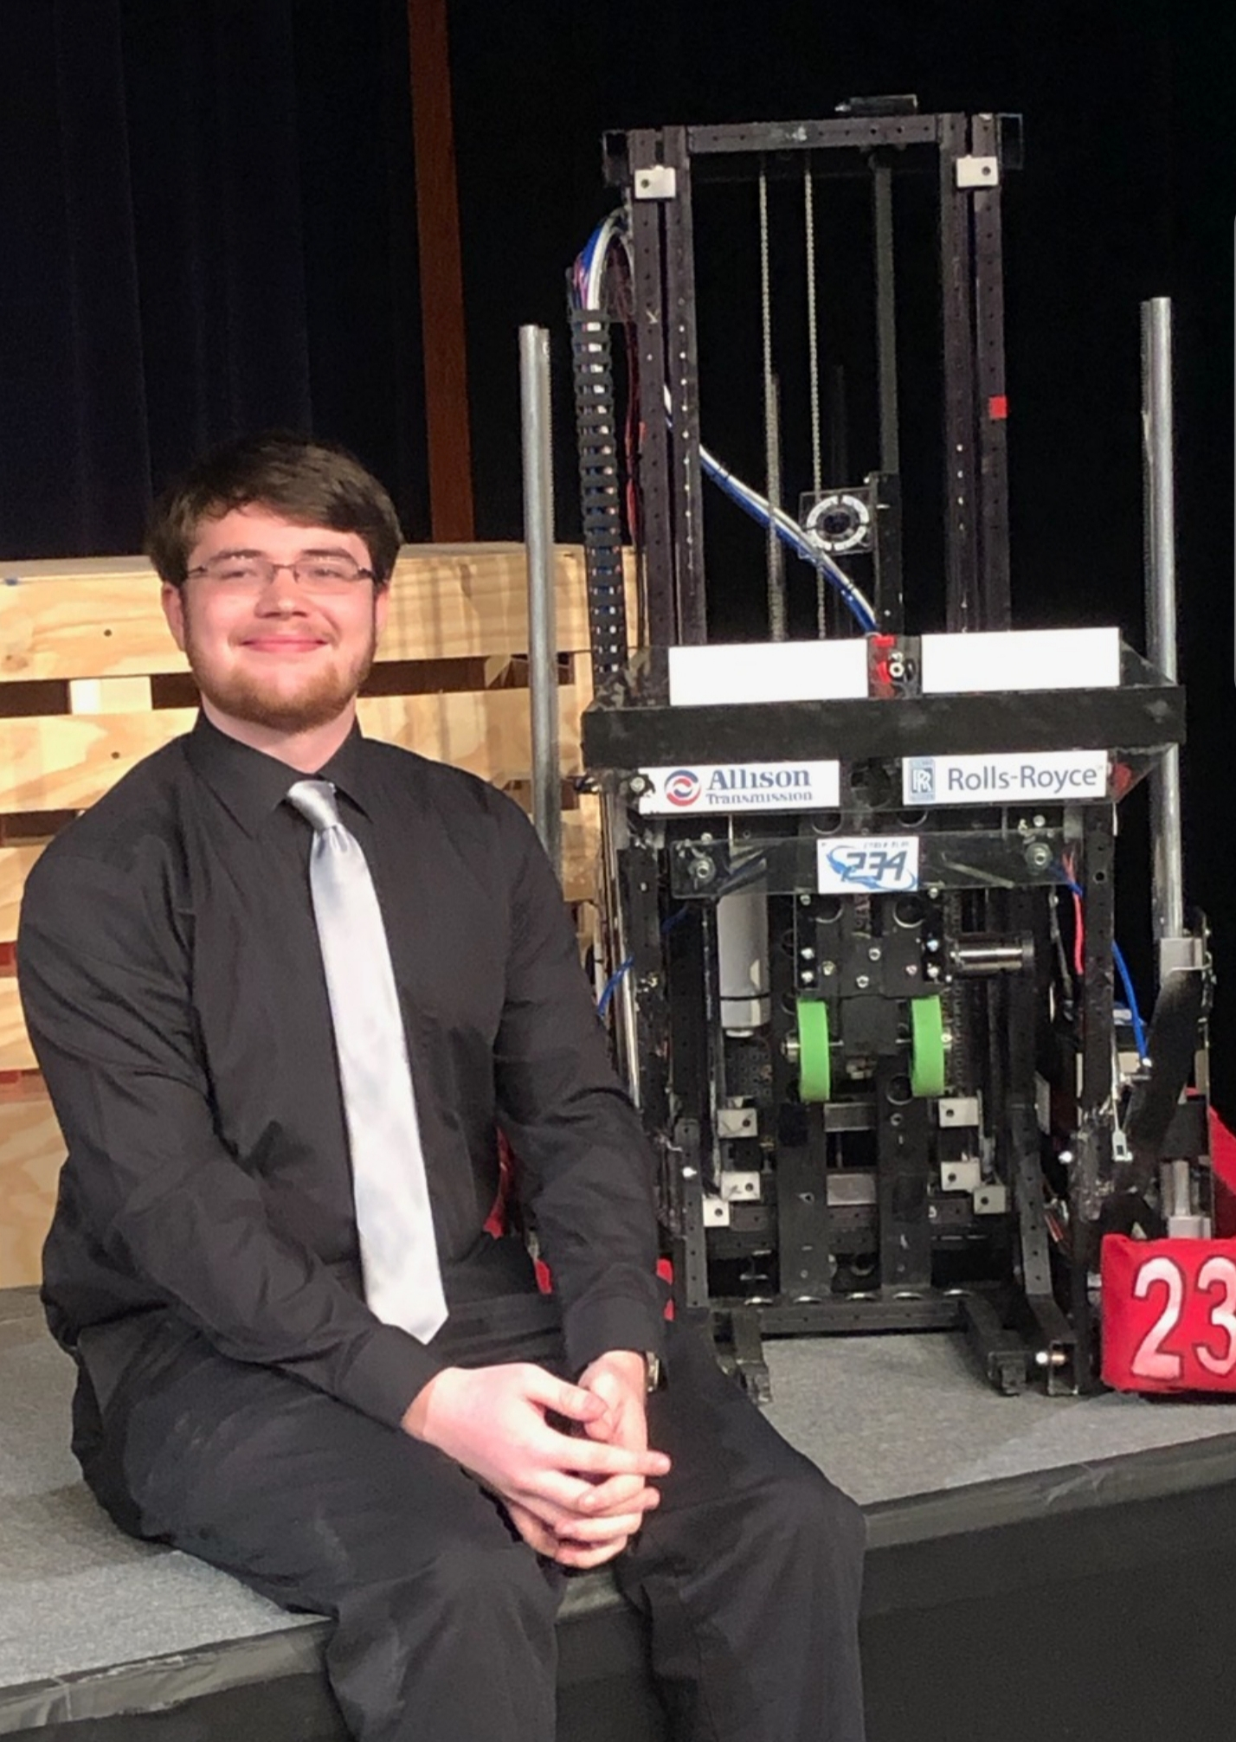
Ryan Herrington
System Manager
B.S. Cyber-Physical Systems Spring 2023
Sensor Unification and Robotics Control
Lead Programmer on Robotics Team
Internship at JFW
Engineer at Crane
5
Notes:
Ryan

Slide 6
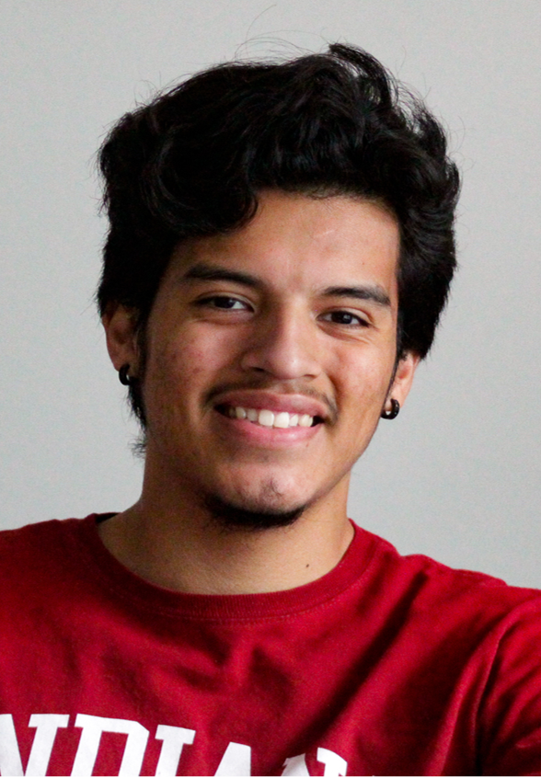
Isaac Navarrete
Presentation Manager
M.S. Intelligent Systems Engineering
Machine Learning and Embedded Systems
Research Assistant at Socioneural Physiology Lab
Engineer at Crane
6
Notes:
Isaac

Slide 7
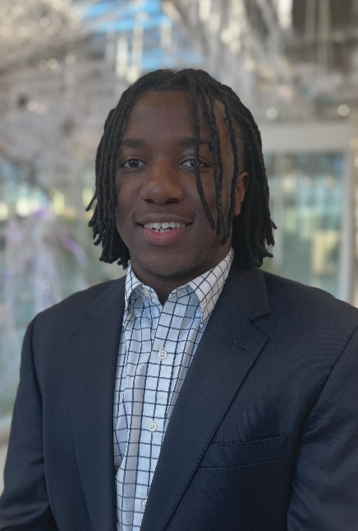
Ben Bamidele
Report Manager
M.S. CPS Spring 2024
Embedded Systems, Machine Learning, Digital Design
Undergraduate Research at Vehicle Autonomy and Intelligence Lab
Internship at Ford Motor Company
7
Notes:
Ben

Slide 8
Project Overview
SECTION 2
8
Notes:
Ryan

Slide 9

Intelligent Systems Engineering! What is it?
Our client, Luddy Outreach, wanted us to develop a system for prospective students to control and engage with using a custom wearable device to help students obtain a better understanding of what ISE students can build using cutting-edge technology at the school of Luddy.
9
Notes:
Ryan

Slide 10
uMove
Product/Project Description:
The overview of our project is to create a wearable device demonstration for Luddy Outreach and Recruiting to help engage with potential ISE students or teach younger students about STEM.
Key Features and/or Operating Modes:
Our project has two key features, the wearable device, and the demonstration that is used with the device. We have successfully interfaced our wearable device with a custom video game. The device controls via fingertip sensors and an Inertial Measurement Unit (IMU).
Key Differentiating Performance(s):
A key difference from normal controller to our device is ours in an intuitive interface.
10
Notes:
Isaac

Slide 11
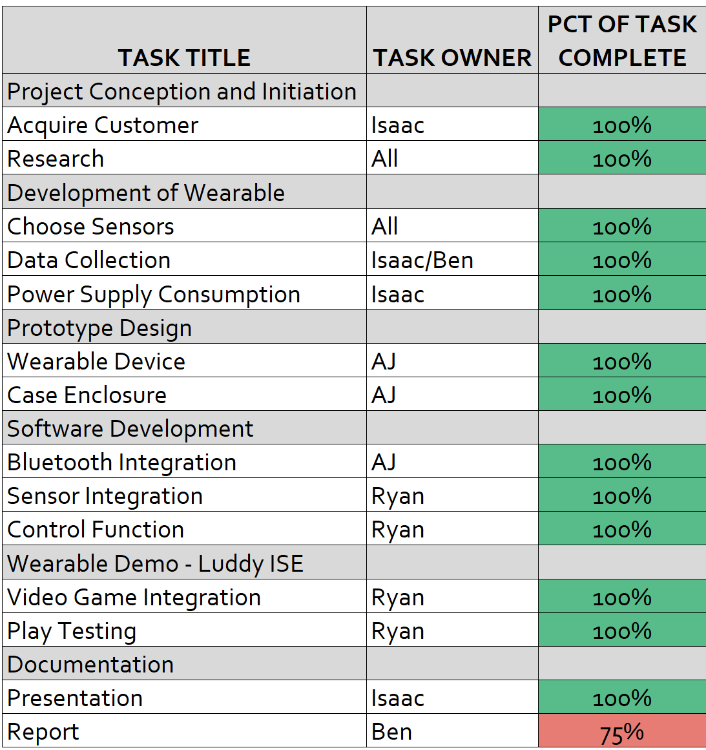
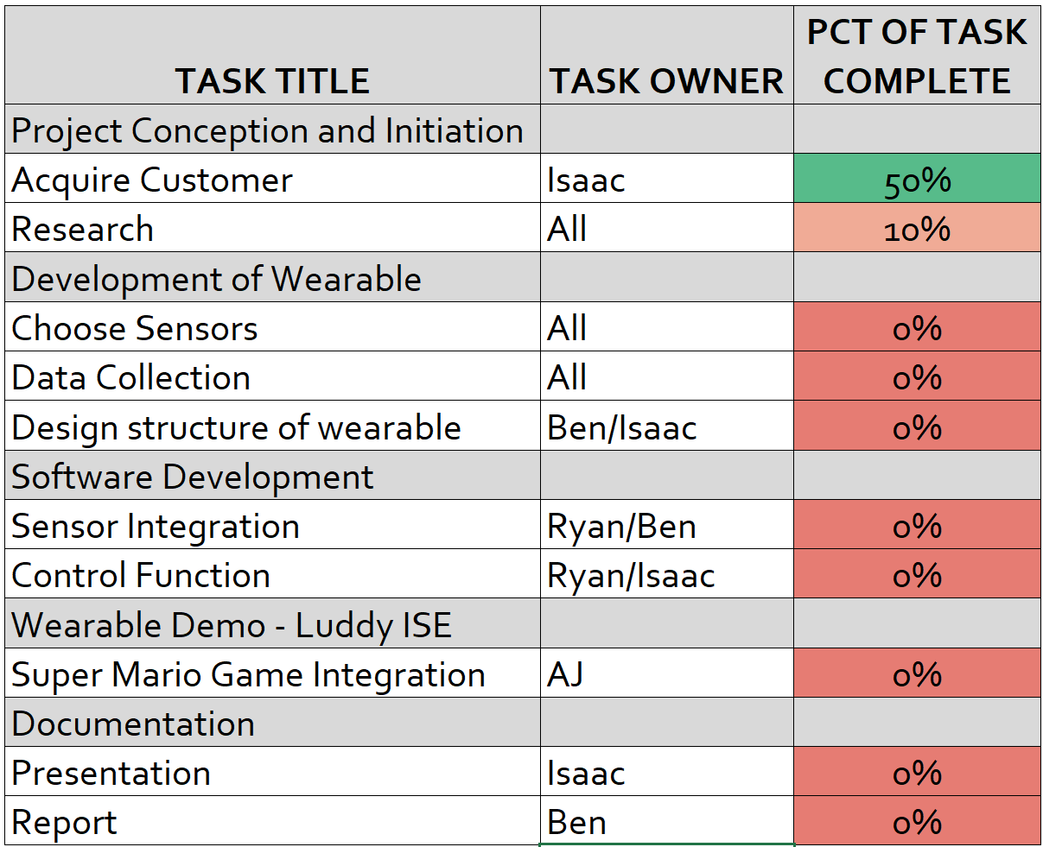
Gantt Chart
Last Chart
First Chart
11
Notes:
AJ

Slide 12
System Overview
SECTION 3
12
Notes:
AJ

Slide 13
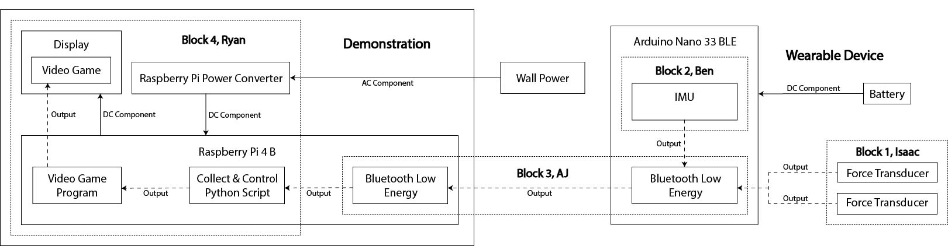
Block Diagram
13
Notes:
AJ

Slide 14
Objectives and Constraints
SECTION 3
14
Notes:
Ben

Slide 15
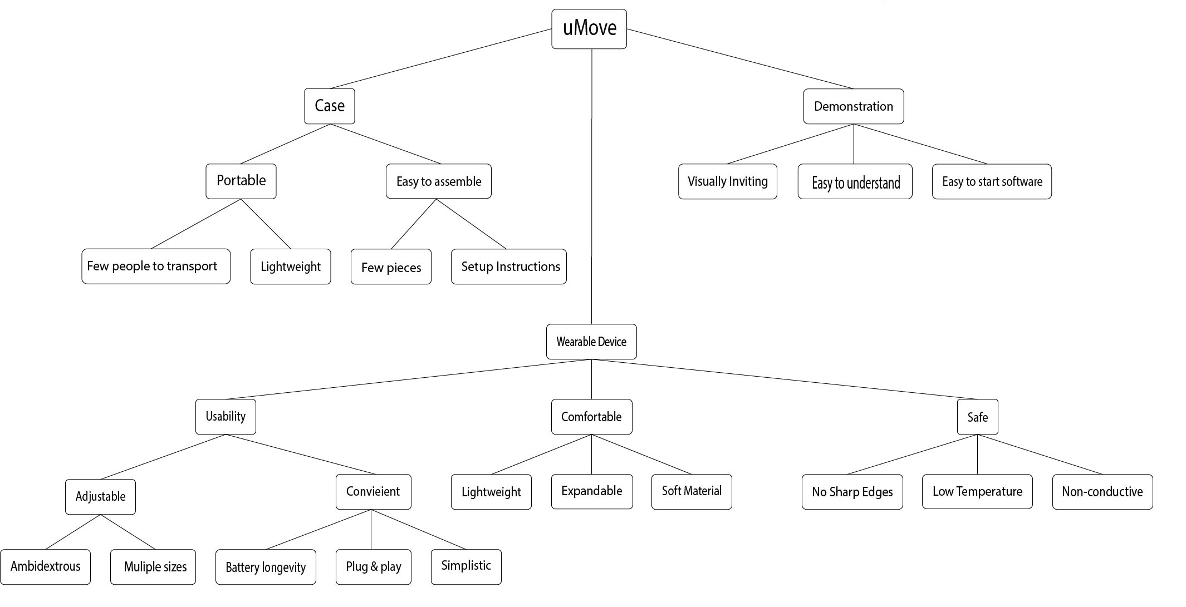
Objectives
15
Notes:
Ben

Slide 16
Constraints
System Section | Constraints
Total System | One person portable | Cannot exceed 15 lbs. | Cannot shock User
Wearable | Battery replaceable | Cannot exceed 2 lbs. | Fit inside case
Case | Rest on table | Safely Secure Glove | Safely contain demonstration
Demonstration | Compatible with wearable | 1-page manual | 2-minute usability
16
Notes:
Ben

Slide 17
Detailed Design Analysis
SECTION 5
17
Notes:
Isaac

Slide 18
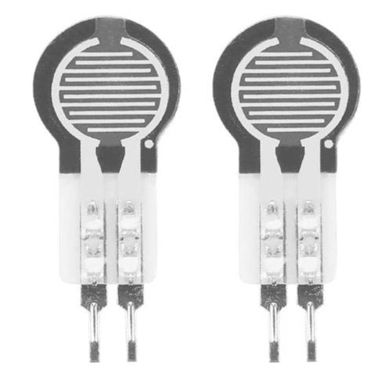
Block 1: Force Transducers and Battery
Block 1: Isaac
Purpose
Create circuit for force transducers
Collect force transducer data
Determine wearable power consumption
Determine battery that will best fit our needs
18
Notes:
Isaac

Slide 19
Block 1: I/O Summary
Block 1: Isaac
Analog Signal | To-From | Type | Directions | Block-Block Interconnect | Unit | Voltage Nominal | Voltage Min | Voltage Max | Description
Force Transducers | Arduino – Sensor | Analog | Input | Wires | V | 0 - 3.3 | 0 | 3.3 | Collects voltage from fingertips
Power Signals | To-From | Type | Direction | Interconnect | Voltage Nominal | Voltage min | Voltage Max | Freq Nominal | Freq min | Freq Max | % V-reg Max | V-Ripple Max | Current Max
Battery Power | Arduino - Battery | DC | Input | No | 9 | 7.2 | 9.6 | DC | N/A | N/A | 0.01 | 1 | 100mA
19
Notes:
Isaac

Slide 20
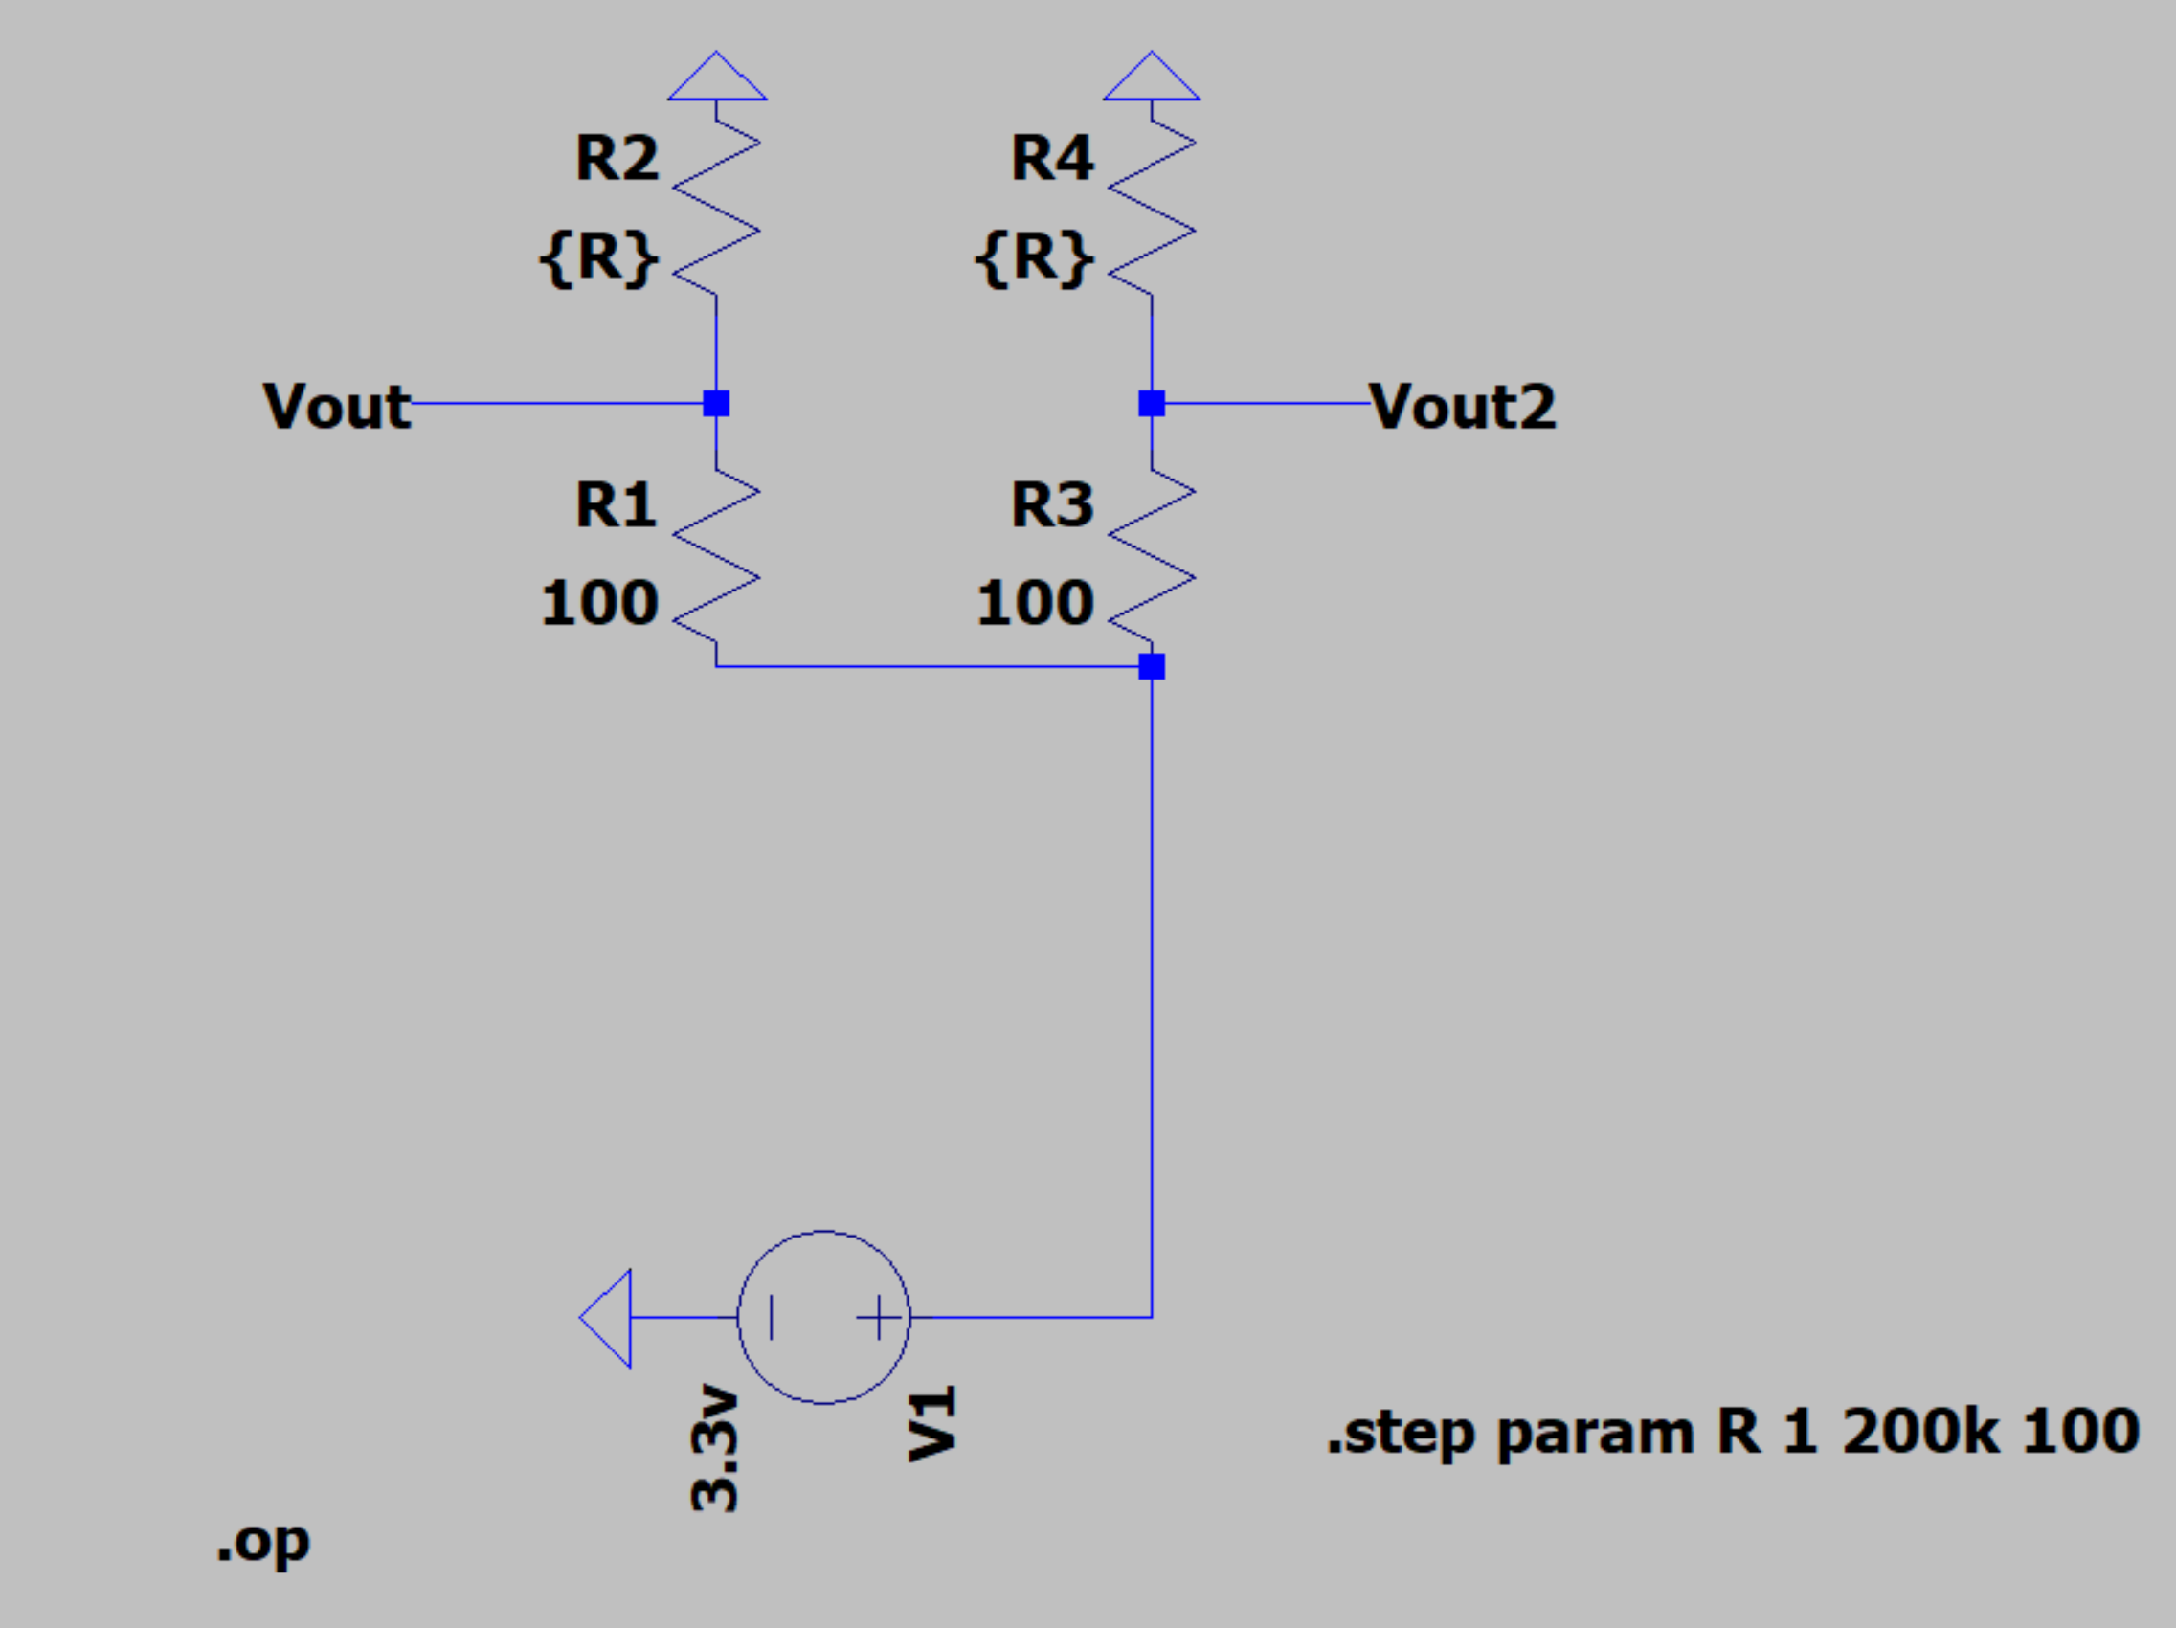
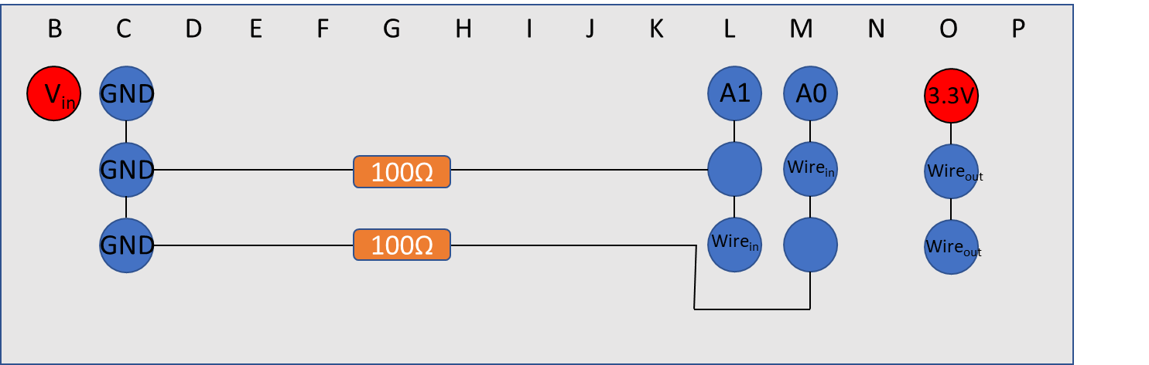
Block 1: Design Schematic
Block 1: Isaac
Simple representation of force sensors circuit and hat
20
Notes:
Isaac

Slide 21
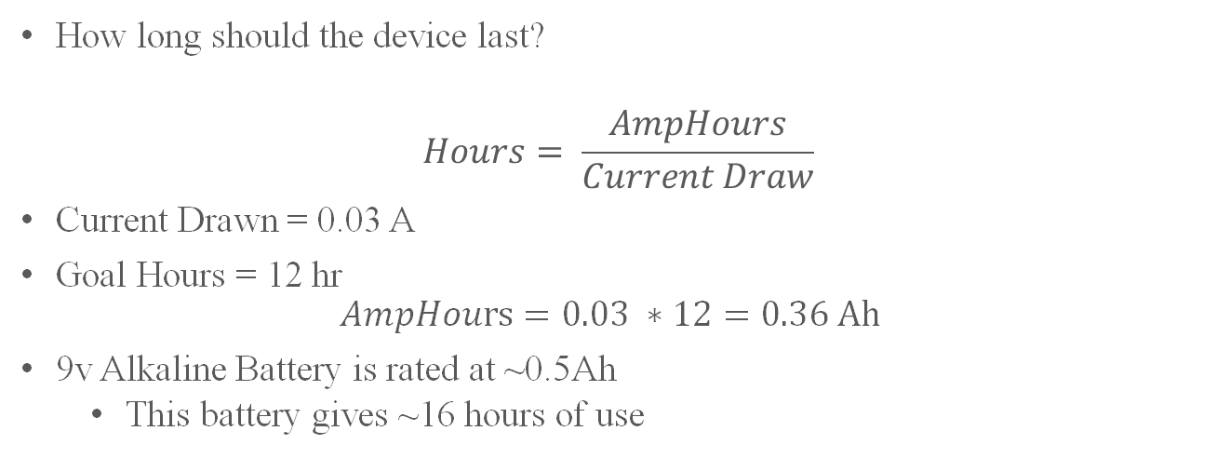
Block 1: Battery Calculations
Block 1: Isaac
How long should the device last?
$$Hours= \frac{AmpHours}{Current Draw}$$
Current Drawn = 0.03 A
Goal Hours = 12 hr
$$AmpHours=0.03 ∗12=0.36 Ah$$
9v Alkaline Battery is rated at ~0.5Ah
This battery gives ~16 hours of use
21
Notes:
Isaac

Slide 22
Block 1: Verification and Testing
Block 1: Isaac
Testing of force transducers
Collect data through serial monitor provided by Arduino
Testing of battery
Use to power Arduino for completely wireless communication
22
Notes:
Isaac

Slide 23
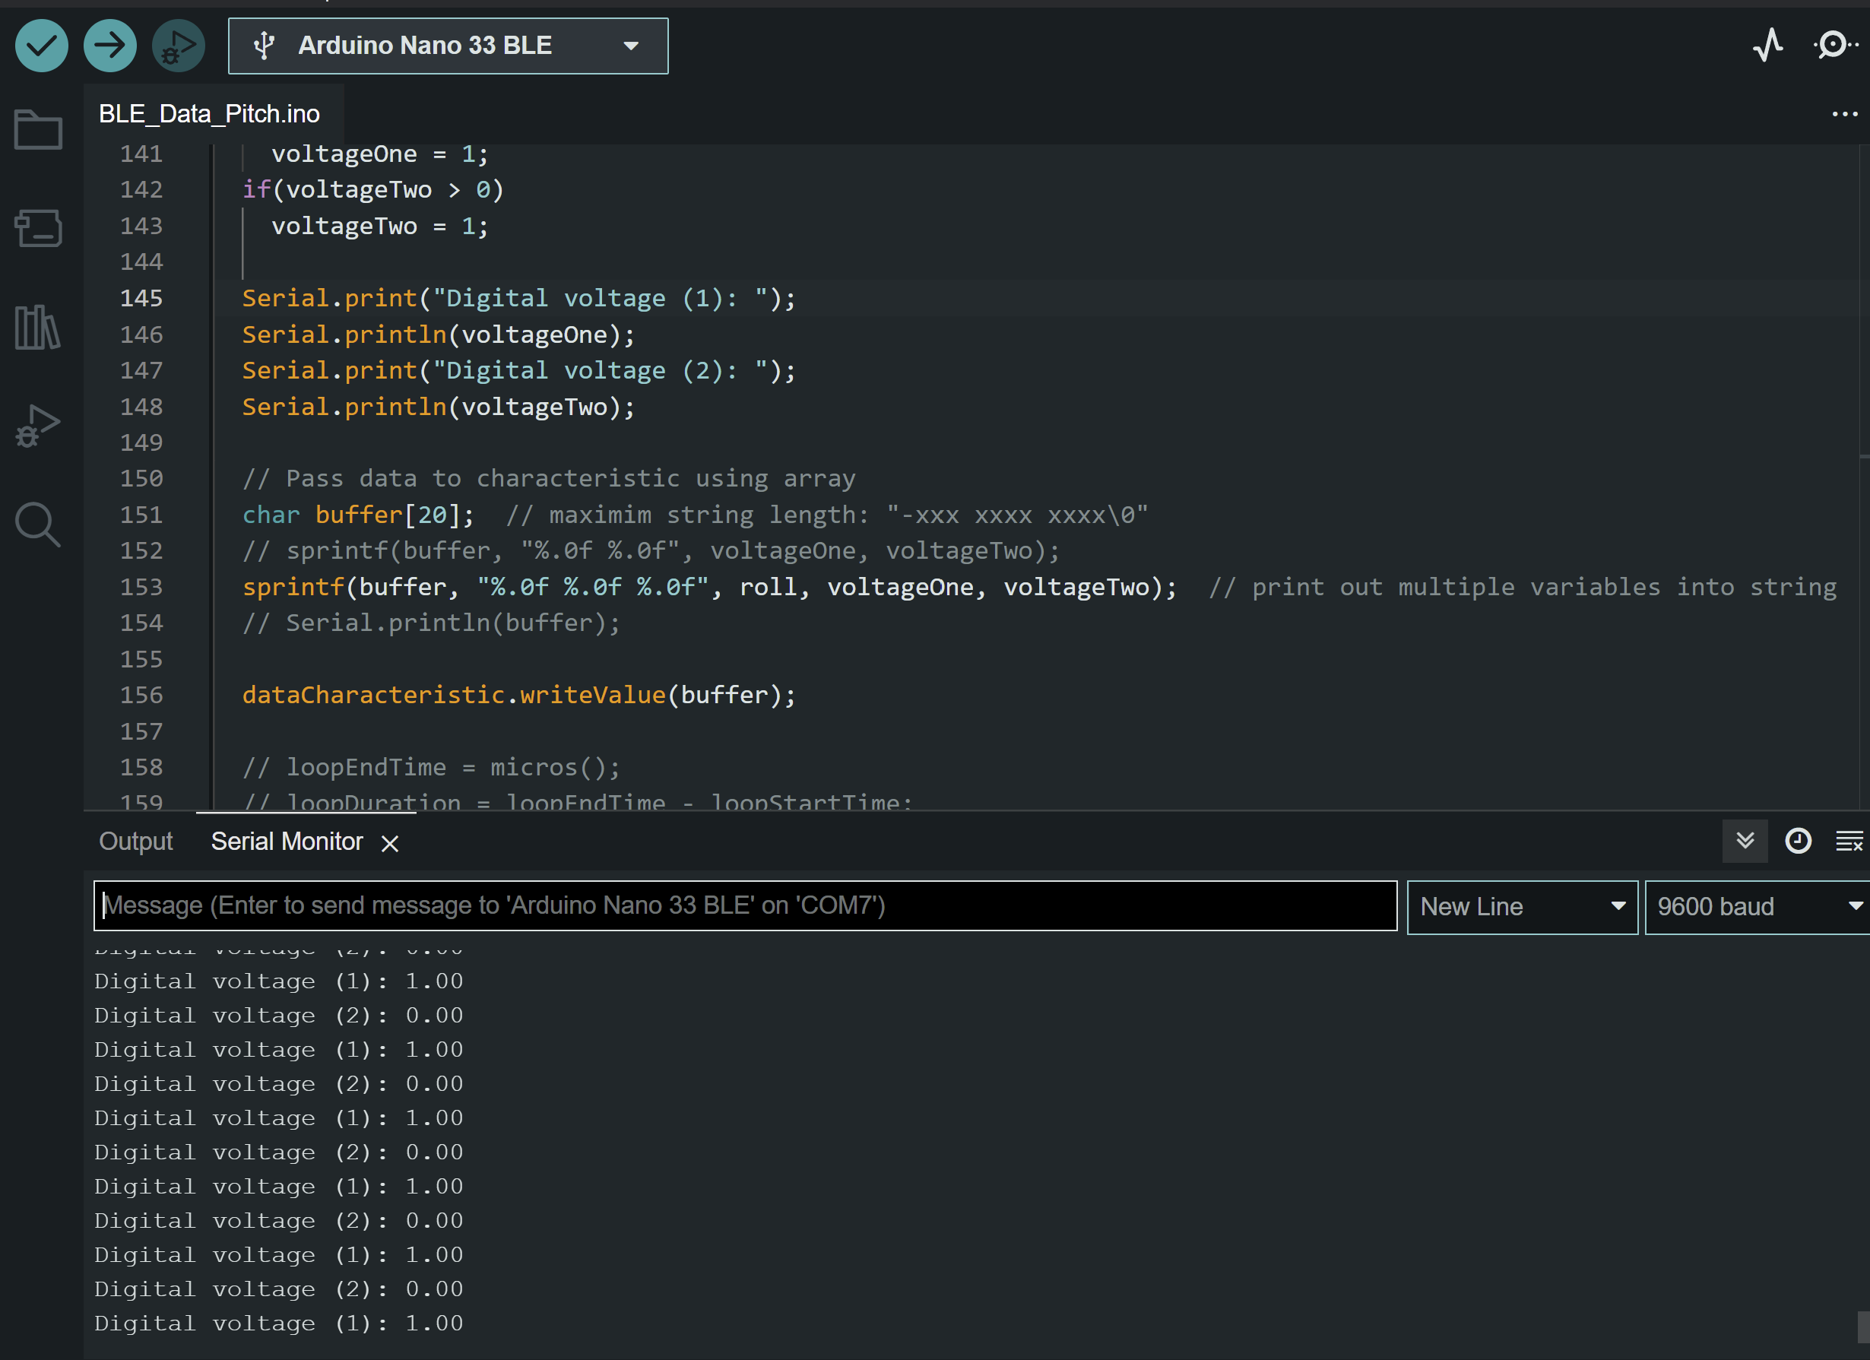
Block 1: Testing Picture
Block 1: Isaac
23
Notes:
AJ

Slide 24
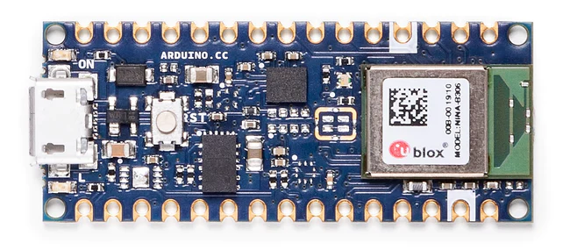
Block 2: IMU
Block 2: Ben
Purpose
Collect IMU data
Calculate desired angles
Data passed off to Bluetooth
Arduino Nano BLE 33
24
Notes:
Ben

Slide 25
Block 2: I/O Summary
Block 2: Ben
Digital Signal | To-From | Type | Directions | Block-Block Interconnect | Unit | Voltage Nominal | Voltage Min | Voltage Max | Description
IMU | Bluetooth – Arduino | Digital | Output | Wires | V | N/A | N/A | N/A | Receives same voltage as Arduino
25
Notes:
Ben

Slide 26
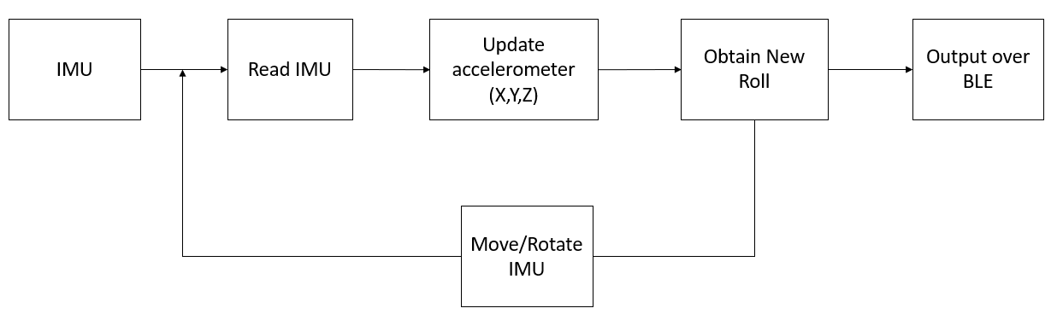
Block 2: IMU
Block 2: Ben
26
Notes:
Ben

Slide 27
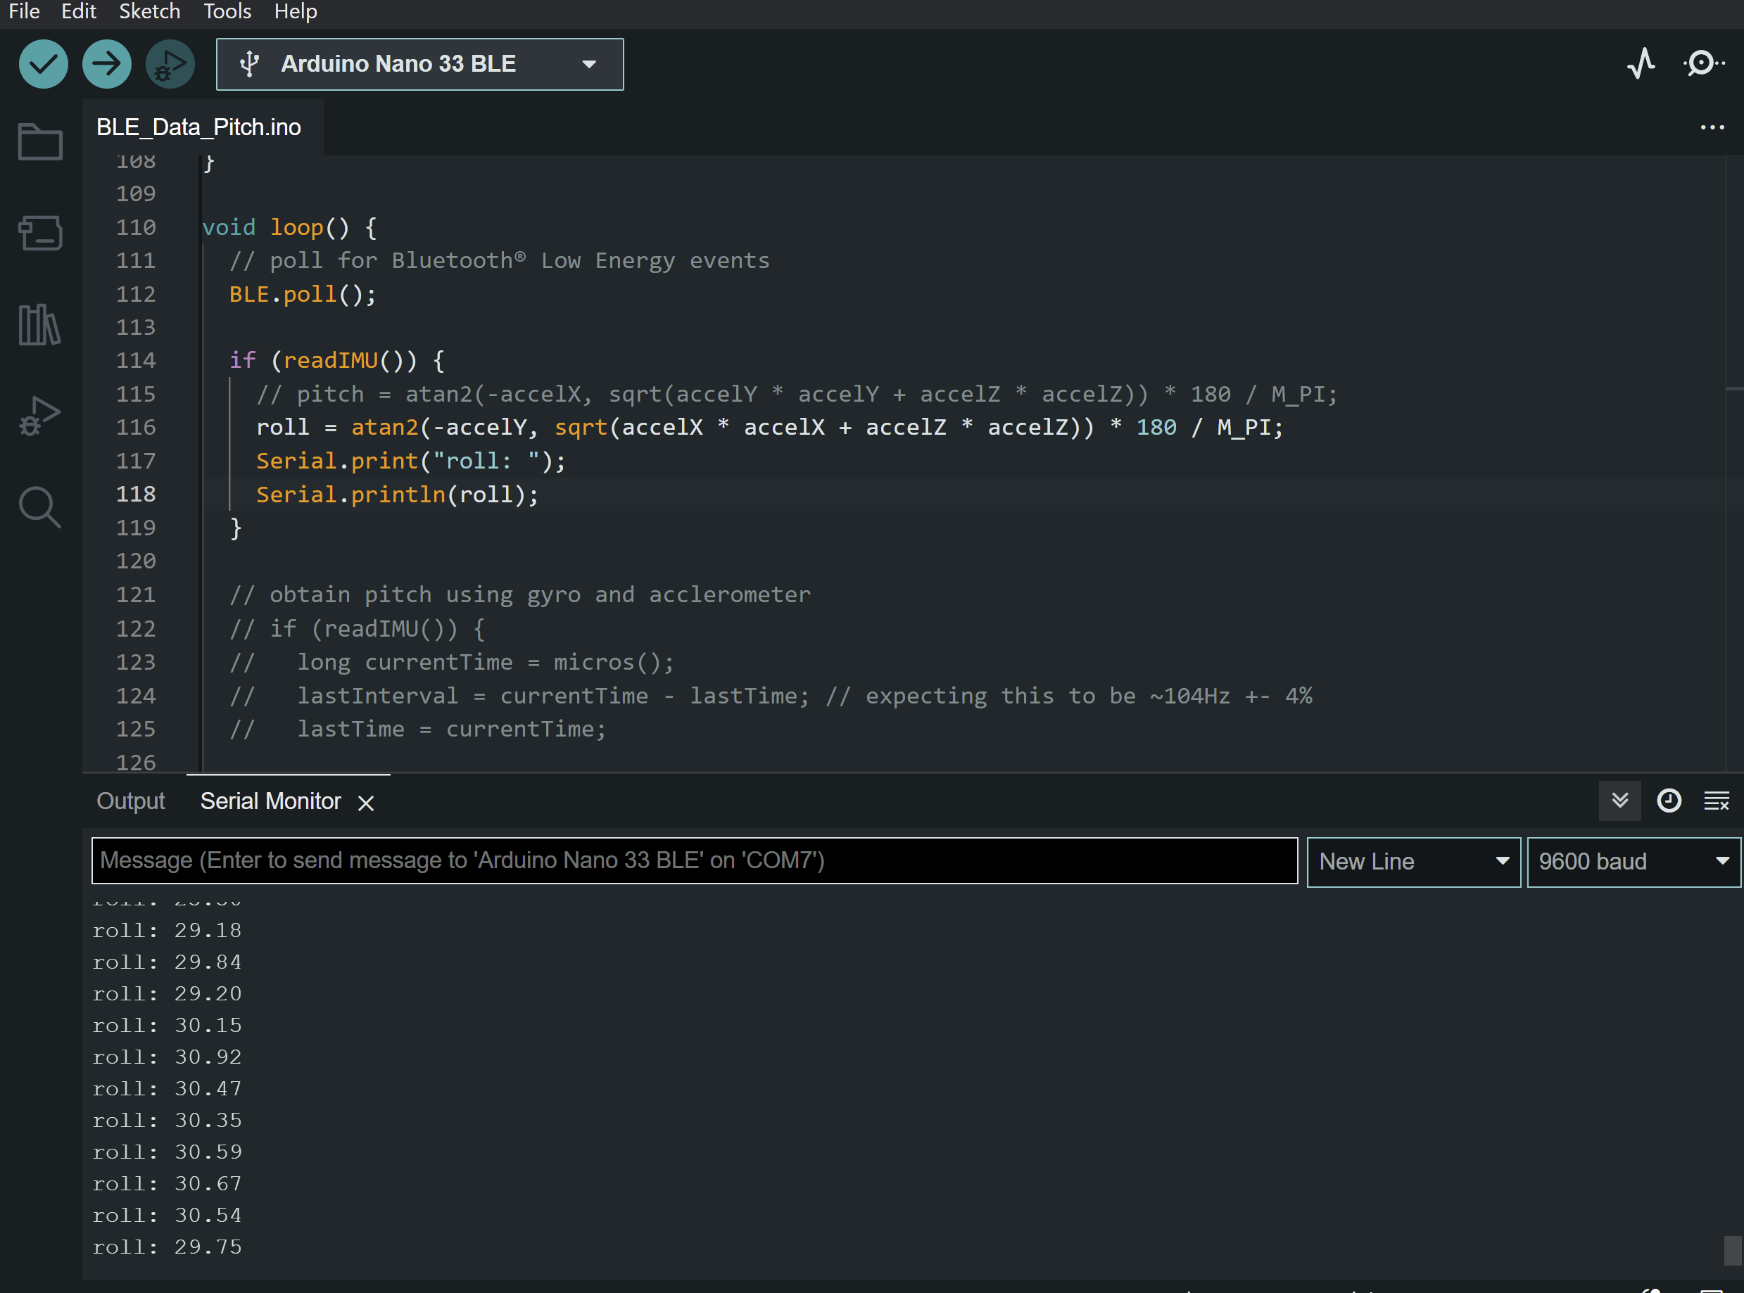
Block 2: Testing Picture
Block 2: Ben
27
Notes:
Insert picture of data collection
Ben/Isaac

Slide 28

Block 3: Bluetooth
Block 3: AJ
Purpose
Allows for a seamless wireless connection
Transmits wearable device data for control algorithm
Communicates between the wearable device and the demonstration
28
Notes:
AJ

Slide 29
Block 3: I/O Summary
Block 3: AJ
Digital Signal | To-From Block #'s | Type | Directions | Block-Block Interconnect | Unit | Voltage Nominal | Voltage Min | Voltage Max | Description
IMU | Block 2 – Block 3 | Digital | Input | Wires | V | N/A | N/A | N/A | Receives same voltage as Arduino
Force Transducers | Block 2 – Block 3 | Digital | Input | Wires | V | 0 - 3.3 | 0 | 3.3 | Collects voltage from fingertips
Bluetooth | Block 3 – Block 4 | Digital | Input/Output | Wireless | V | N/A | N/A | N/A | Transmits IMU/sensor data between devices
29
Notes:
AJ

Slide 30
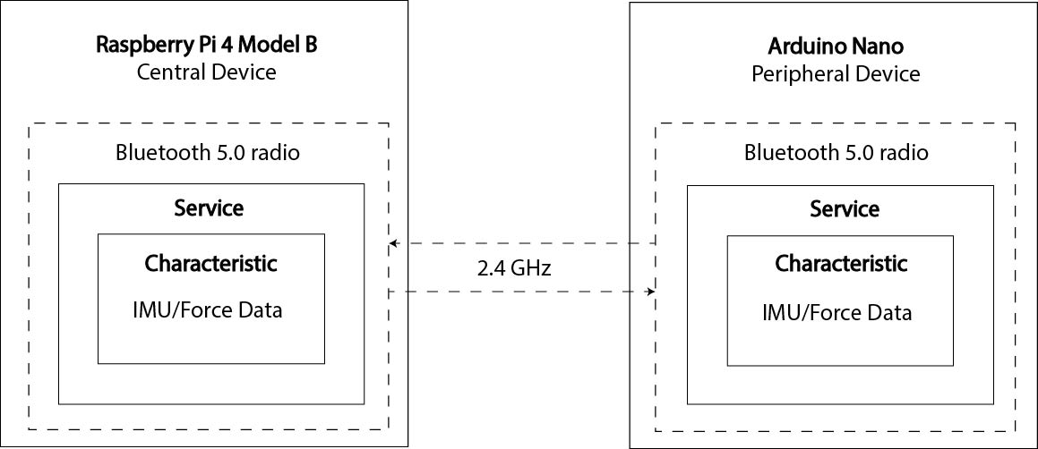
Block 3: Communication Diagram
Block 3: AJ
30
Notes:
AJ

Slide 31
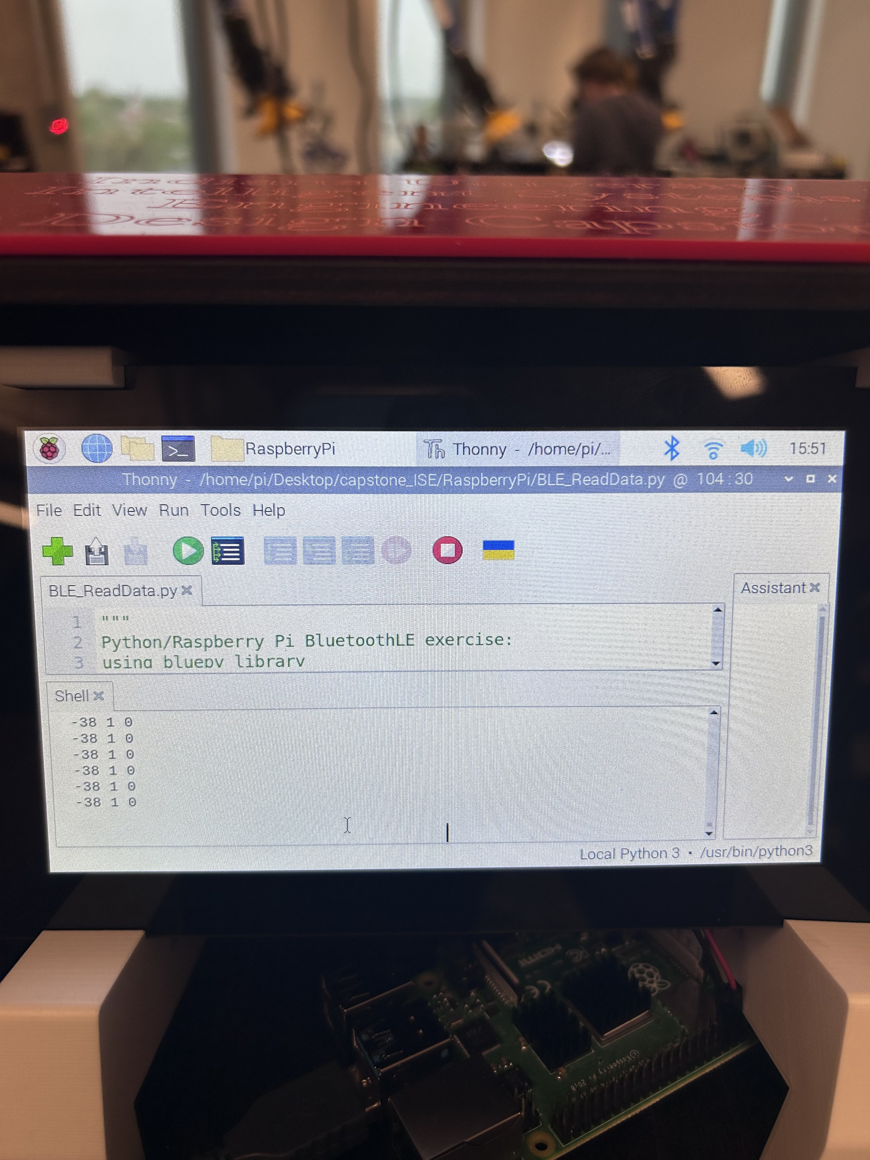
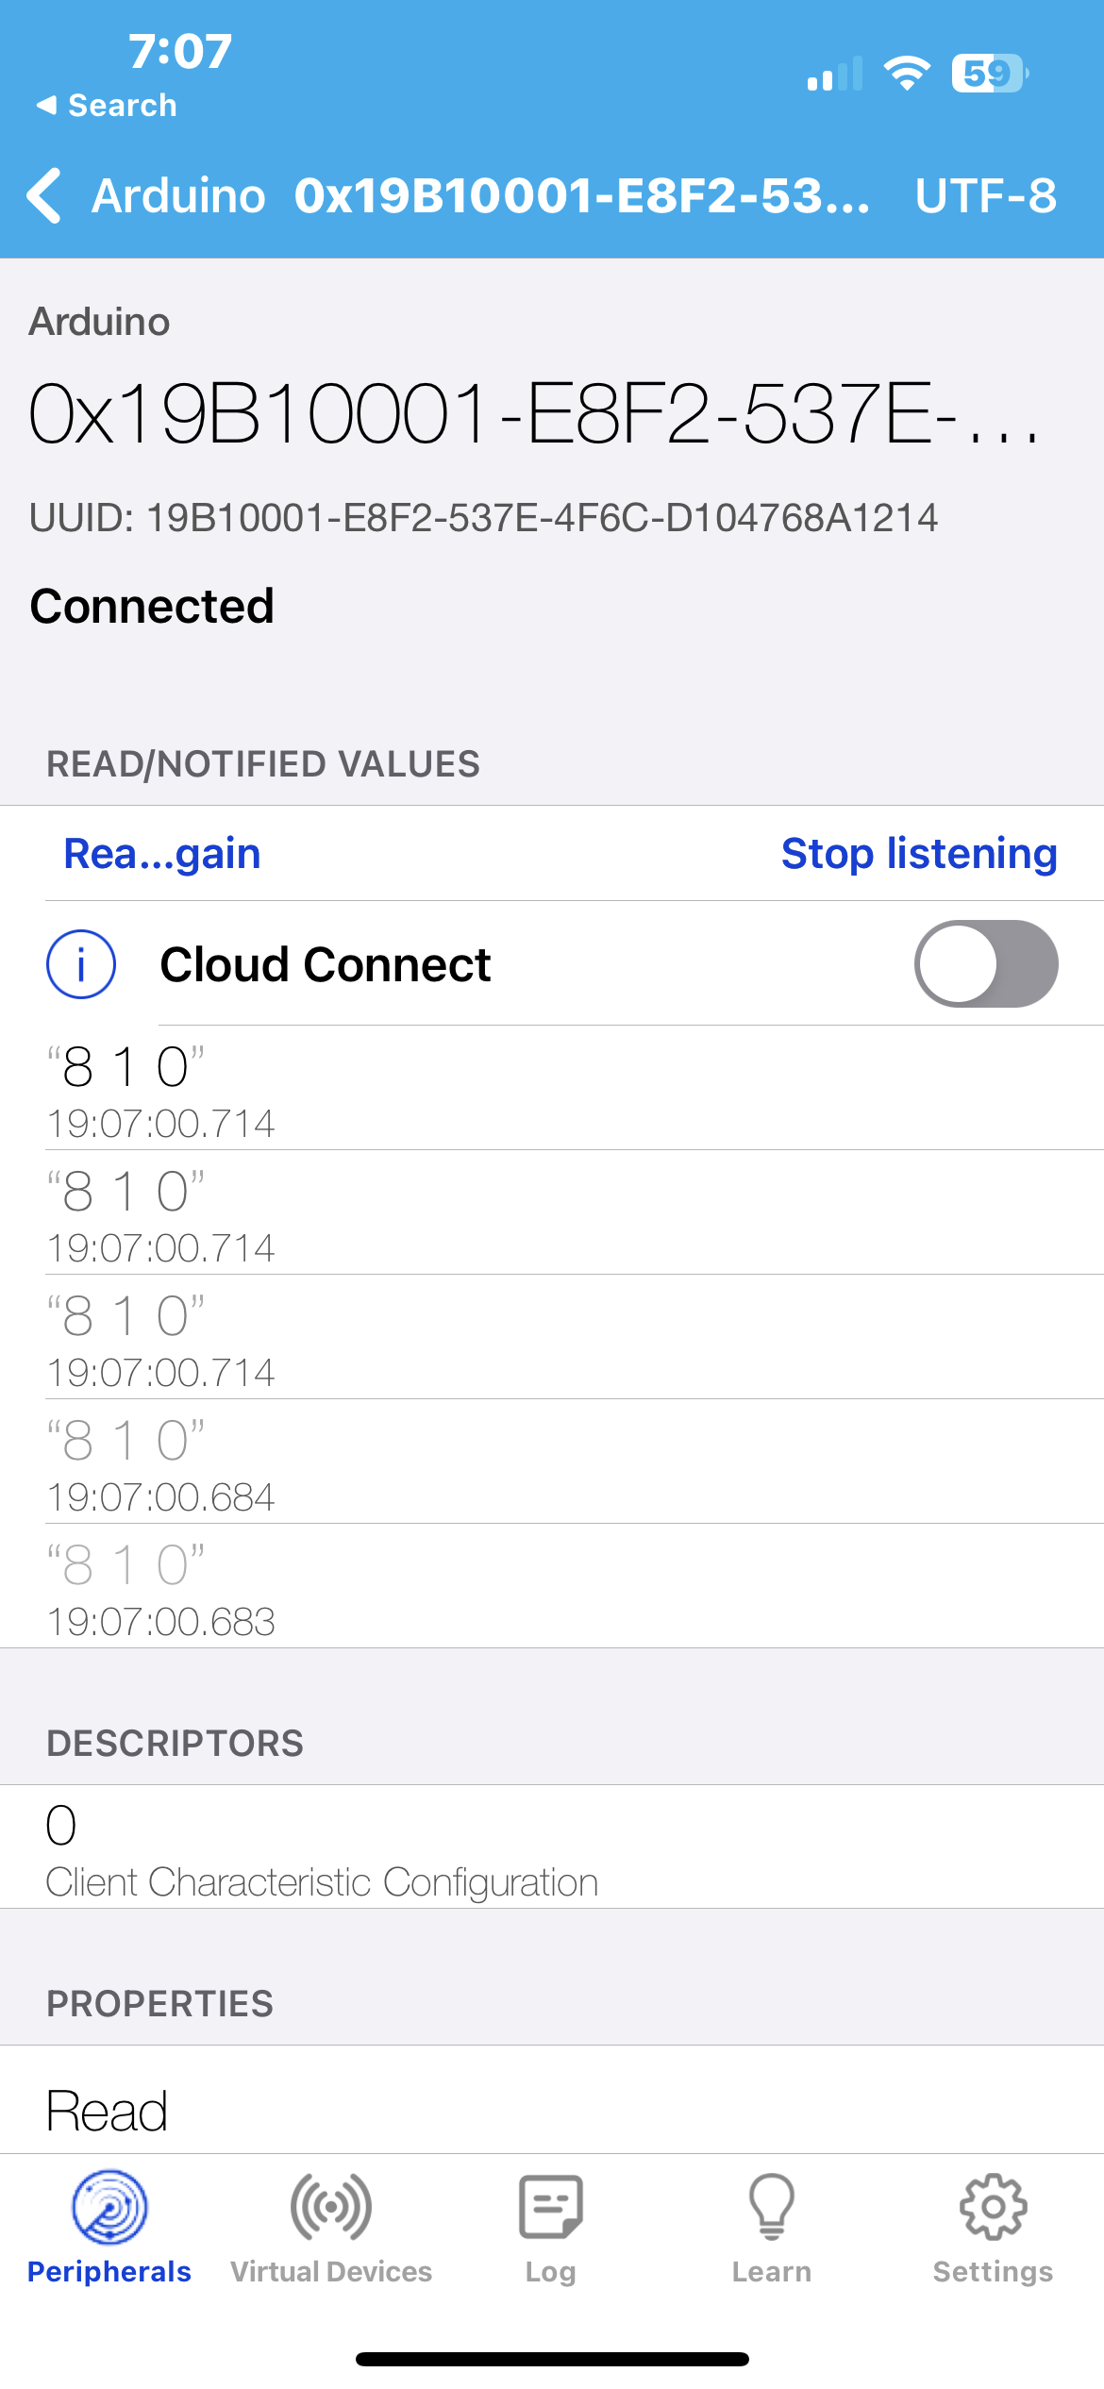
Block 3: Testing and Verification
Block 3: AJ
Light Blue Application
Raspberry Pi
31
Notes:
AJ

Slide 32
Block 4: Demonstration
Block 4: Ryan
Purpose
Receive data from Bluetooth Handler
Parse data and convert to keyboard inputs
Run video game and display for participant
Hold the screen at an optimal display angle
32
Notes:
Ryan

Slide 33
Block 4: I/O Summary
Block 4: Ryan
Power Signals | To-From | Type | Direction | Interconnect | Voltage Nominal | Voltage min | Voltage Max | Freq Nominal | Freq min | Freq Max | % V-reg Max | V-Ripple Max | Current Max
Wall Input | Converter-Wall Outlet | AC | Input | No | 120 | 102 | 132 | 60 | 57 | 63 | 0.01 | 1 | 1
Converter Input | Raspberry Pi-Converter | DC | Input | No | 5 | 4.75 | 5.25 | DC |  | N/A | 0.01 | 1 | 3
Digital Signals​ | To-From​ | Type​ | Direction​ | Interconnect​ | Coupling​ | Voltage Max​
Bluetooth Data​ | Demonstration - Bluetooth | Digital​ | Input​ | Wireless​ | Wireless​ | N/A​
33
Notes:
Ryan

Slide 34
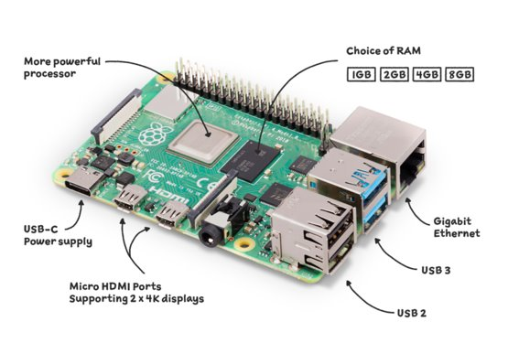
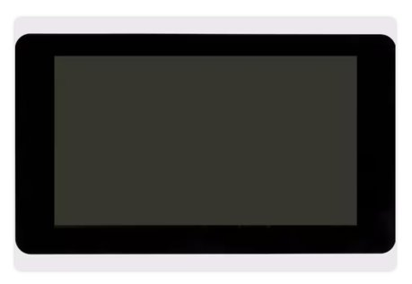
Block 4: Hardware
Block 4: Ryan
Raspberry Pi 4 Model B
Bluetooth
Raspberry Pi 7” Touch screen
34
Notes:
Ryan

Slide 35
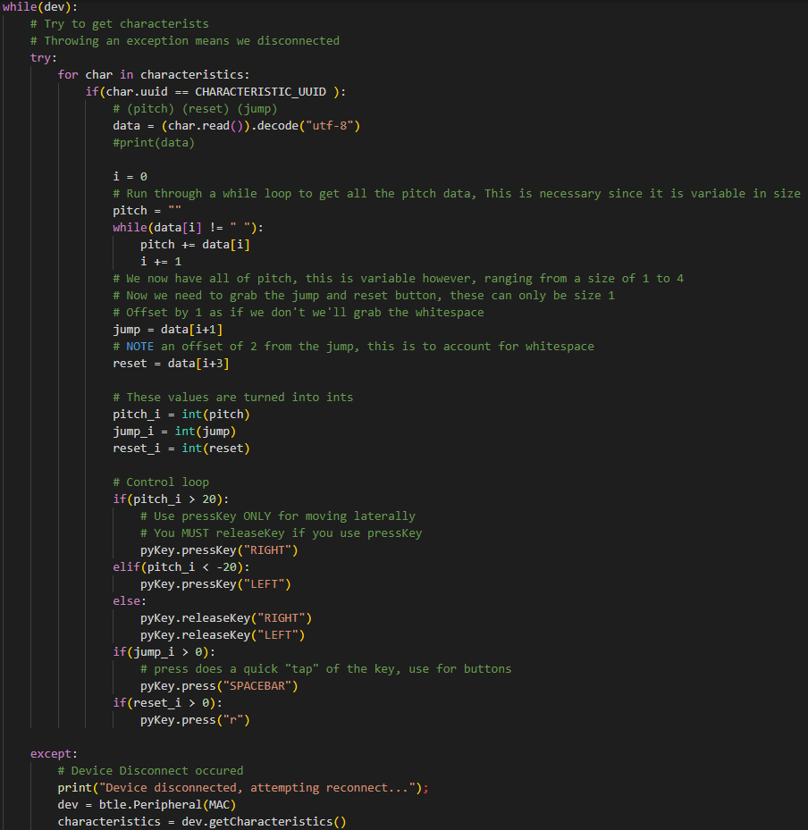
Block 4: Ryan
Block 4: Middleware
Input: Bluetooth Data
Output: keyboard inputs for video game
35
Notes:
Ryan

Slide 36
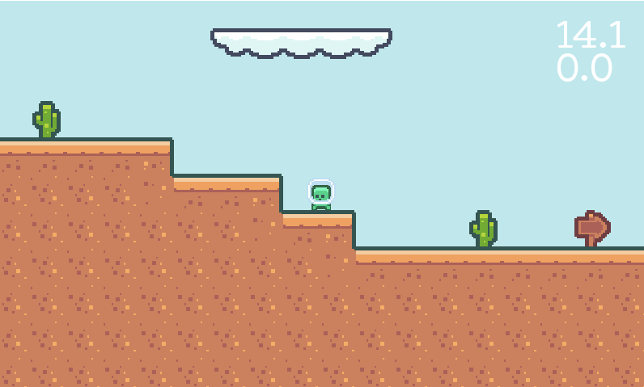
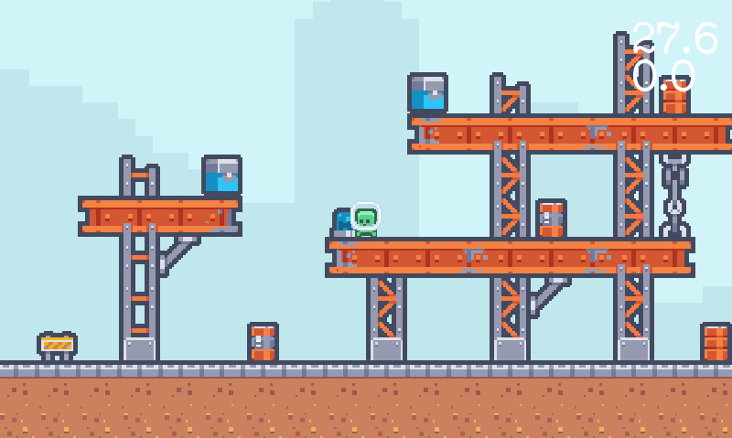
Block 4: Ryan
Block 4: Video Game
Game Engine: Godot
Input: Keyboard
Output: Game to display
36
Notes:
Ryan

Slide 37
Block 4: Ryan
Block 4: Testing and Verification
3 Phases
Phase 1: Testing game on local computer
Phase 2: Testing game on Raspberry Pi
Phase 3: Testing game on Pi with Wearable
37
Notes:
Ryan

Slide 38
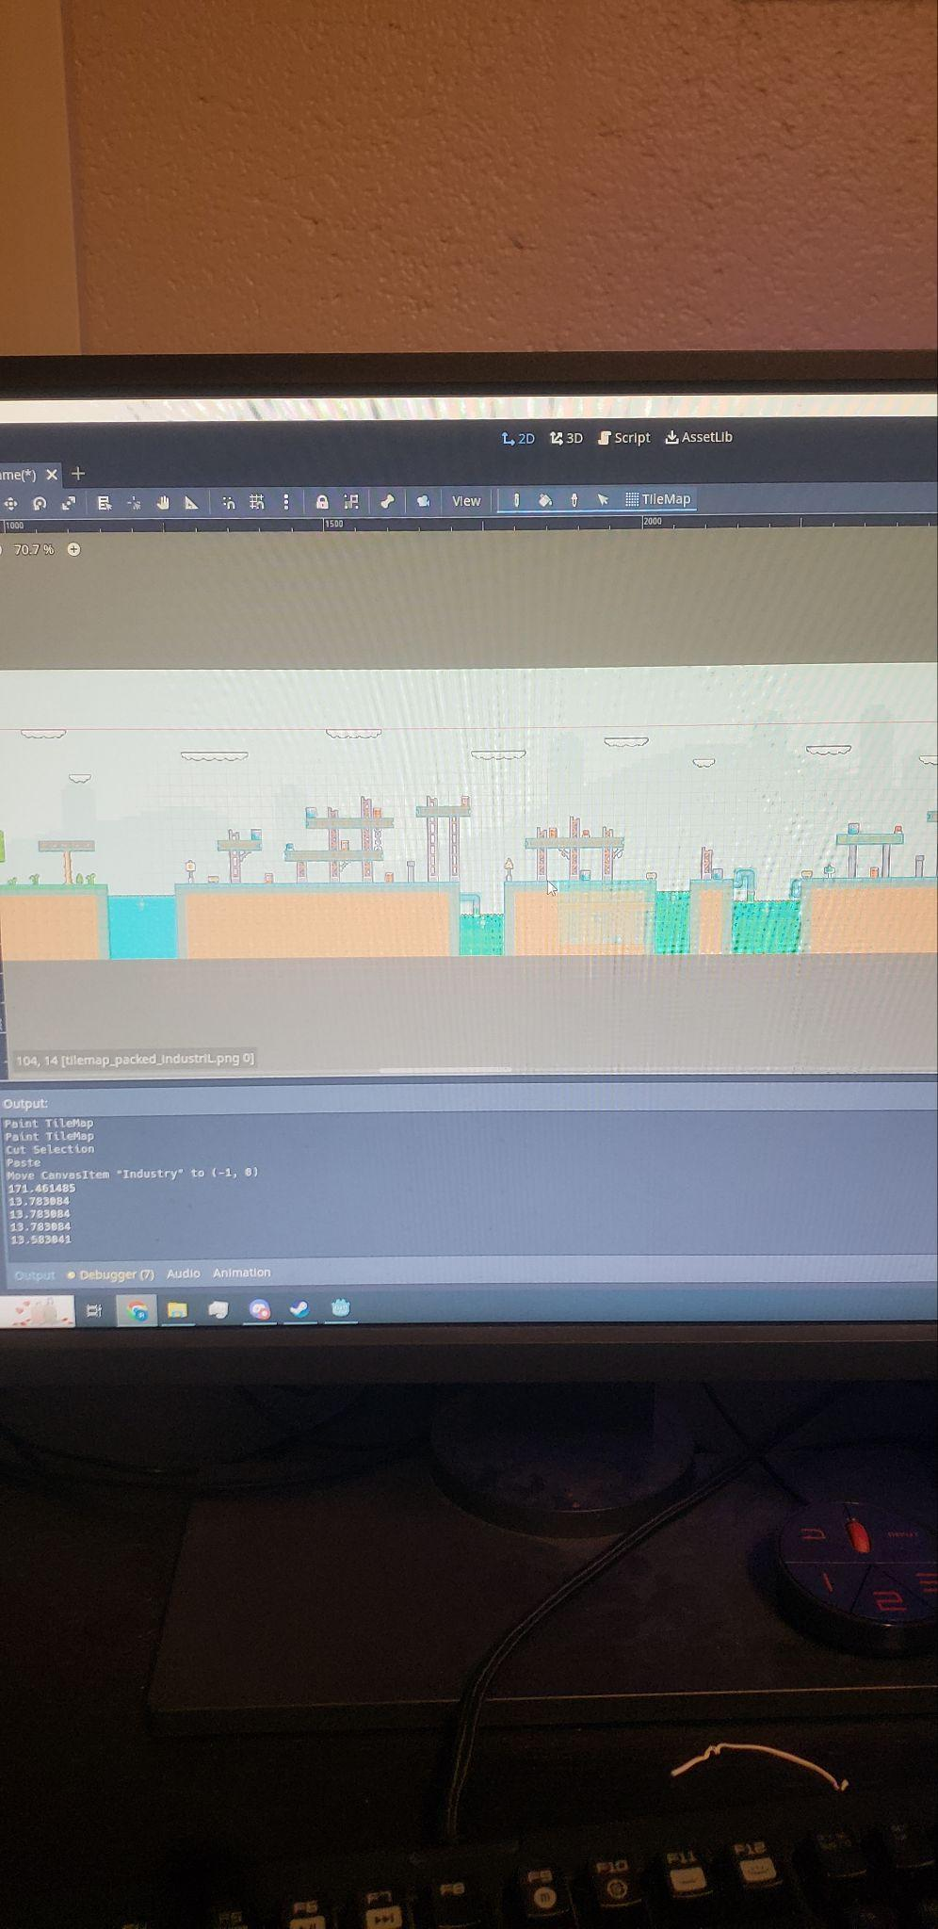
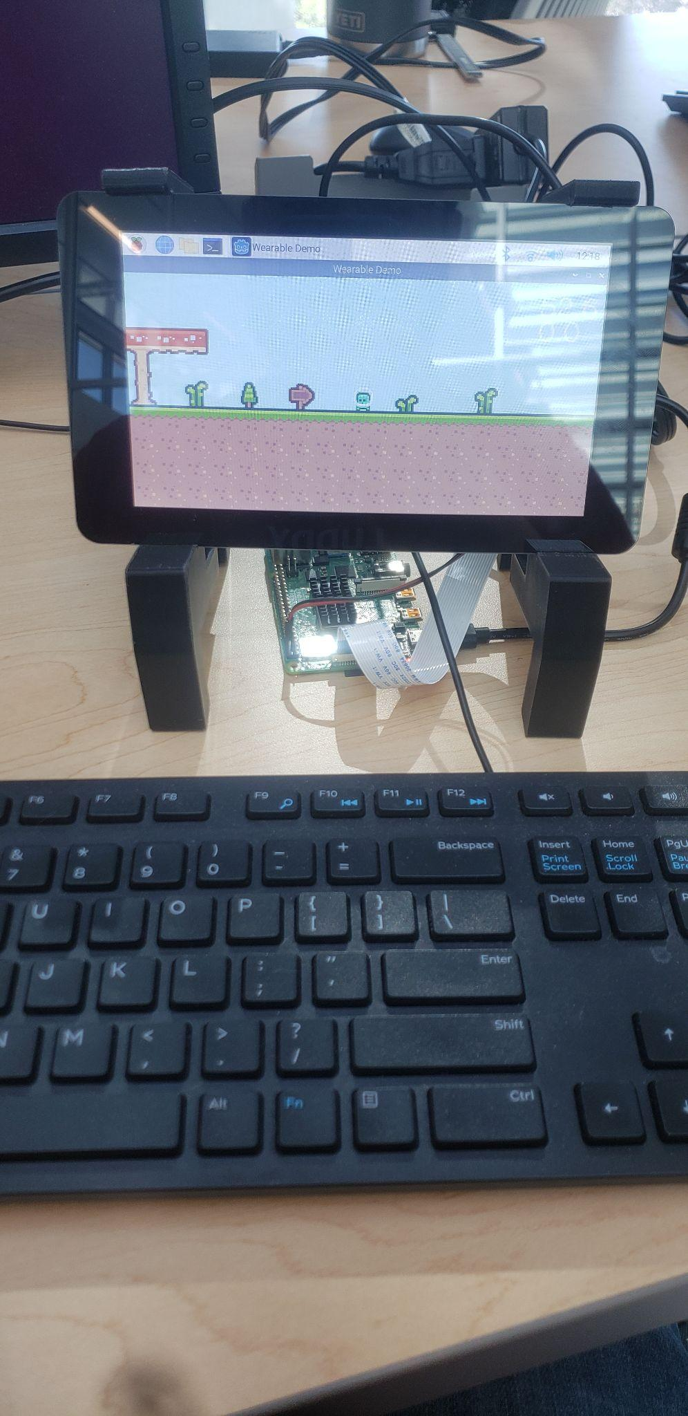
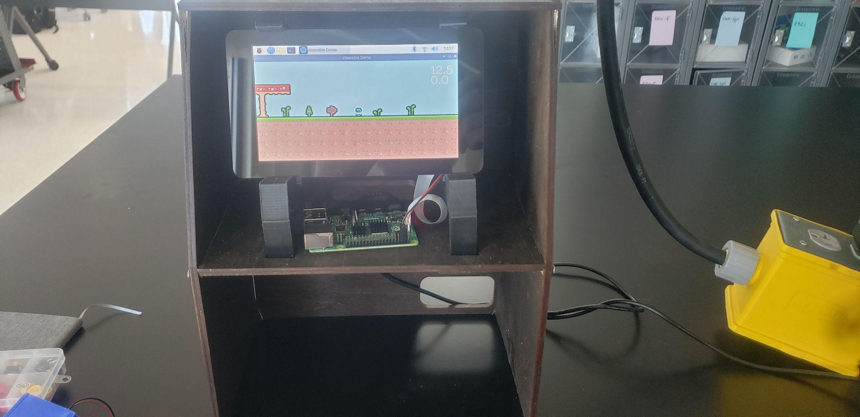
Block 4: Ryan
Block 4: Testing Pictures
Testing Phase
1
Testing Phase
2
Testing Phase
3
38
Notes:
Ryan

Slide 39
AJ
Prototype Enclosures
Purpose
Protect our hardware
Prevent harm to users
Provide storage for extra supplies
39
Notes:
AJ

Slide 40
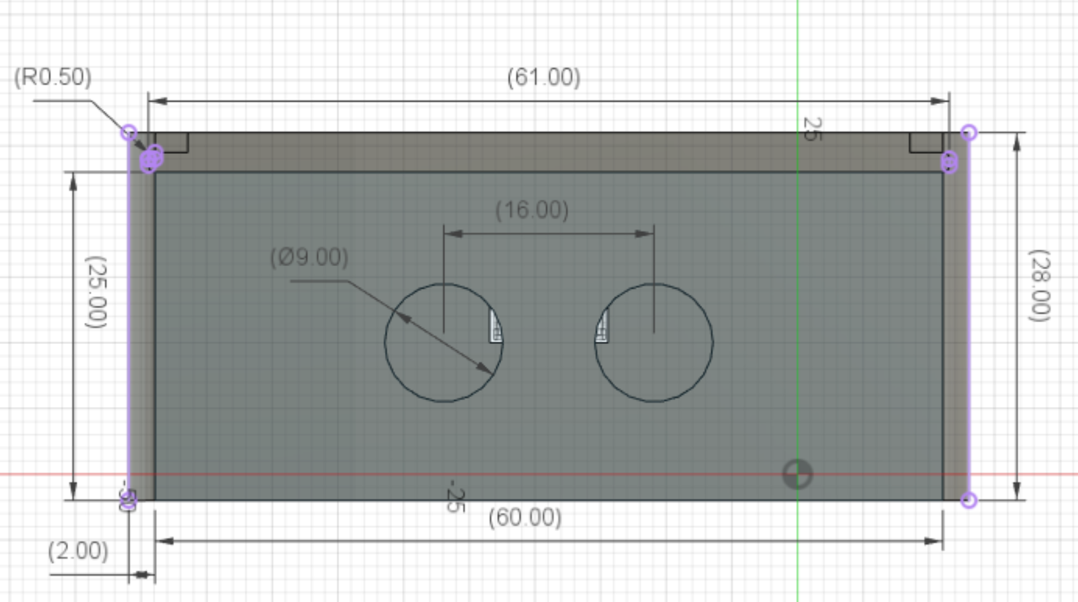
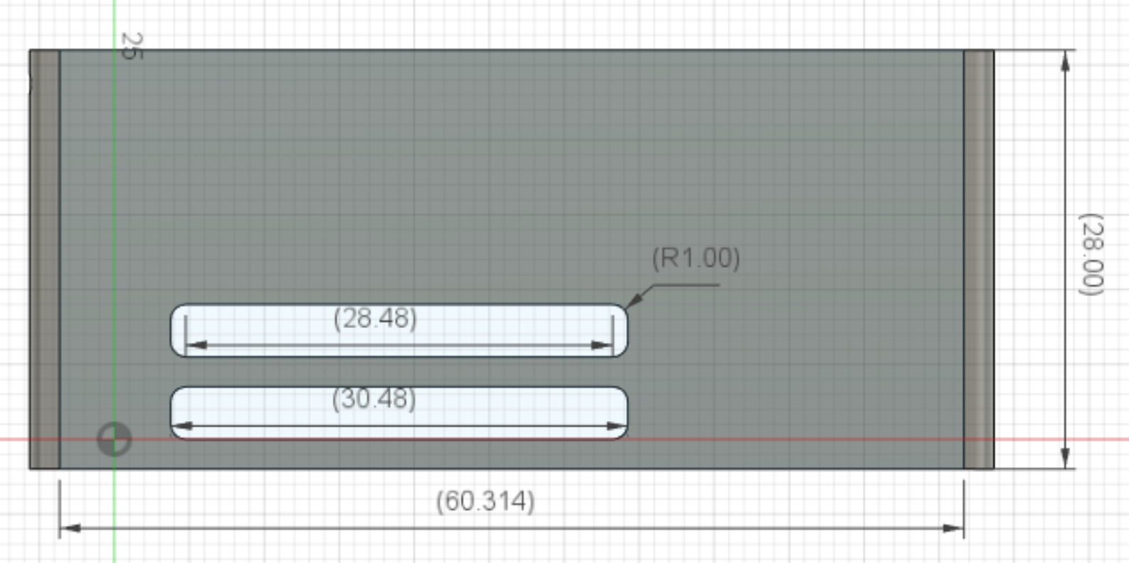
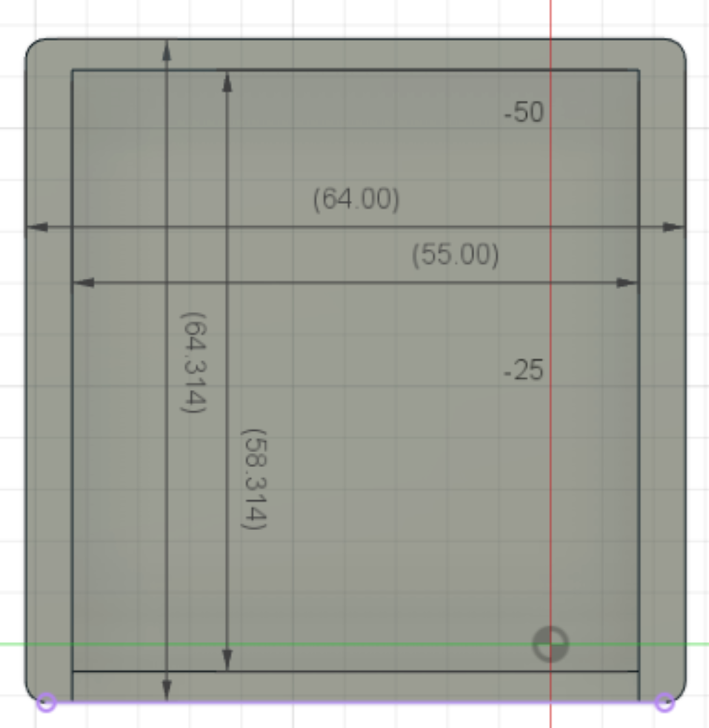
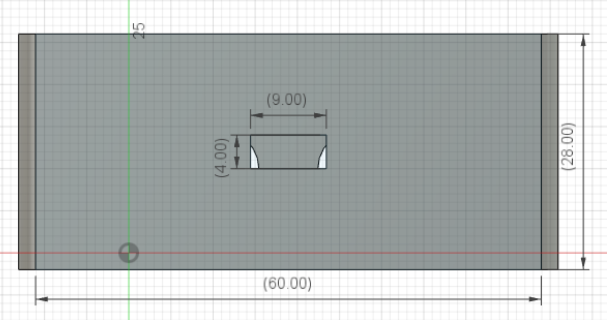
AJ
Prototype Design – Wearable
40
Notes:
AJ

Slide 41
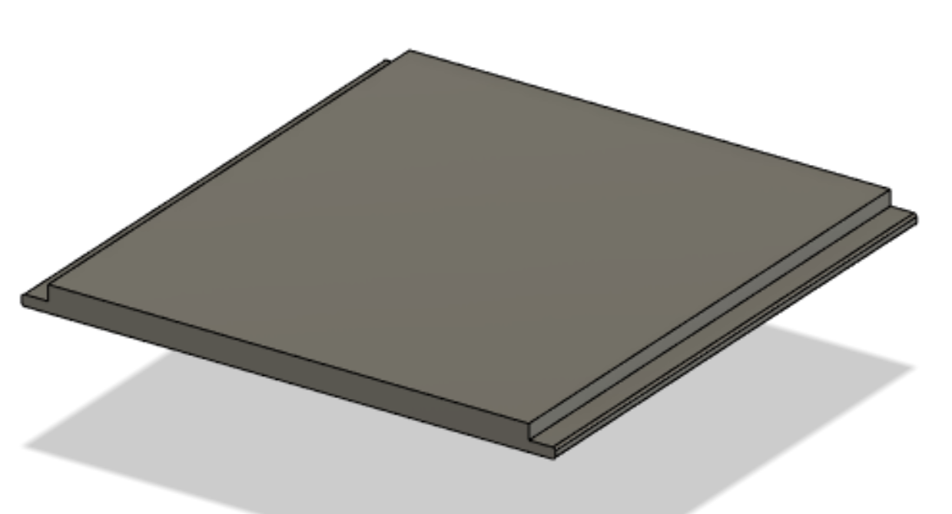
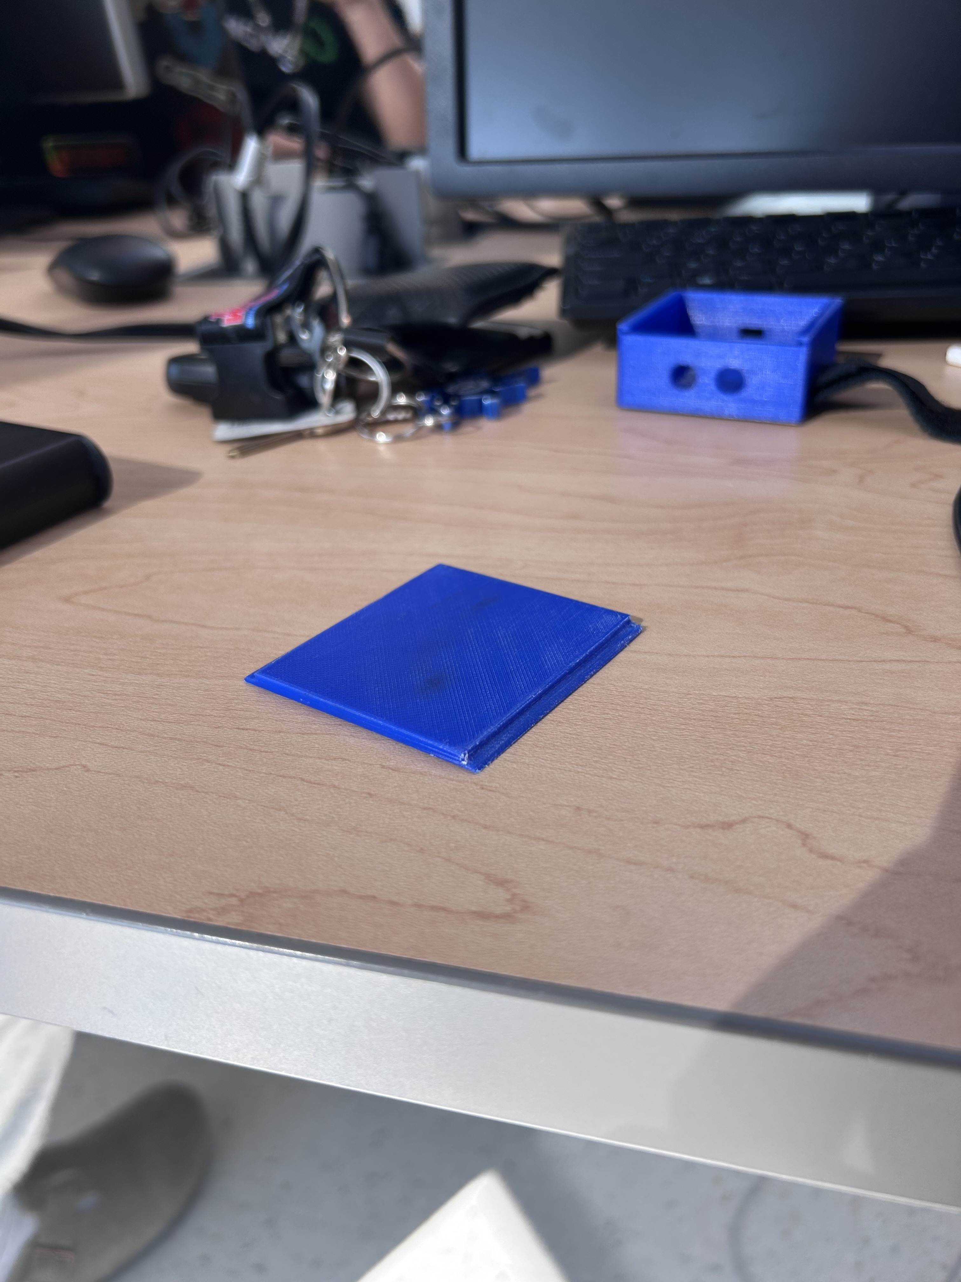
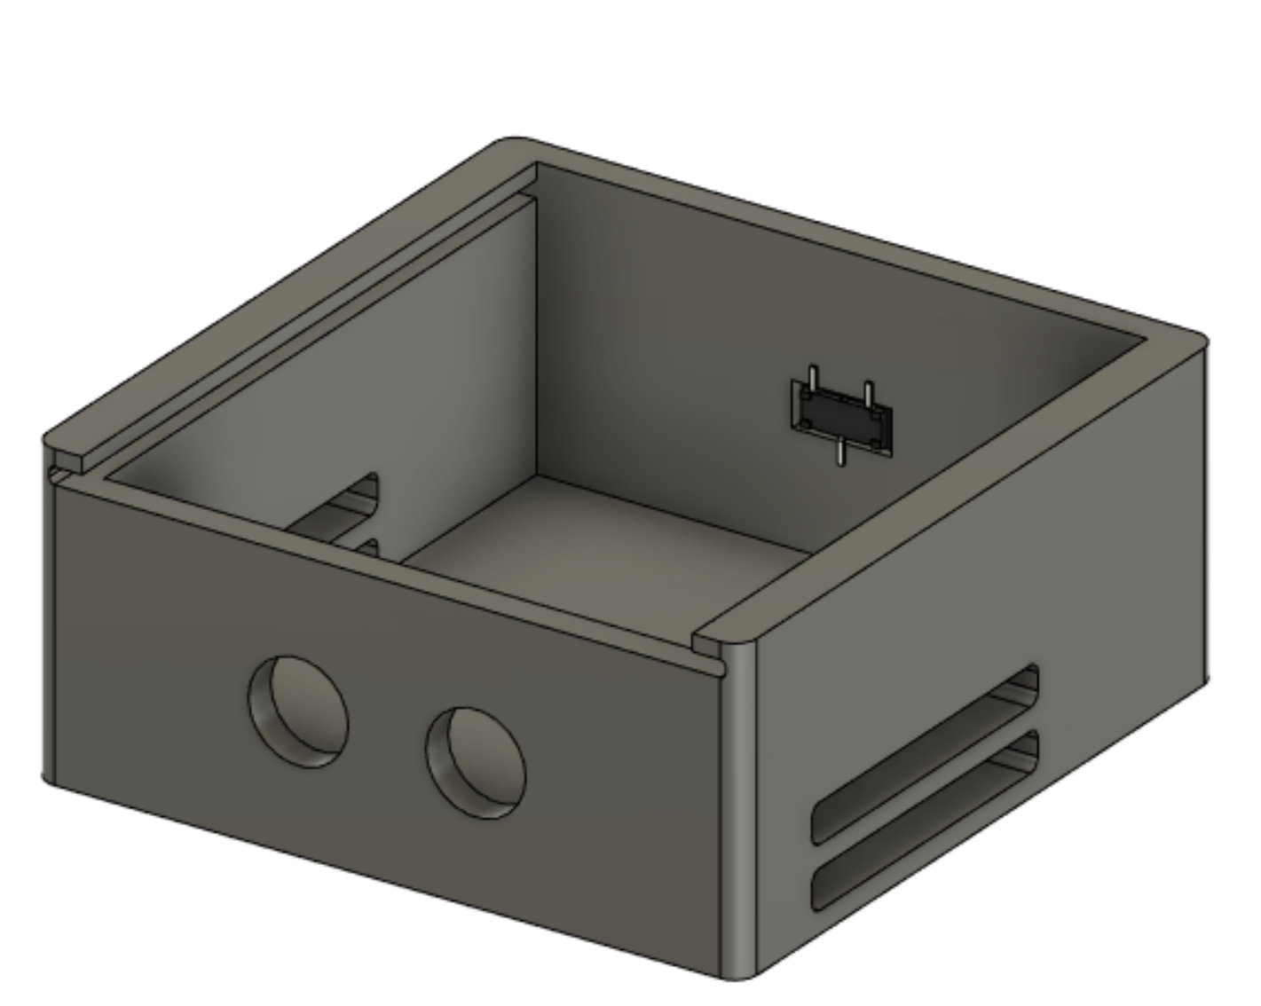
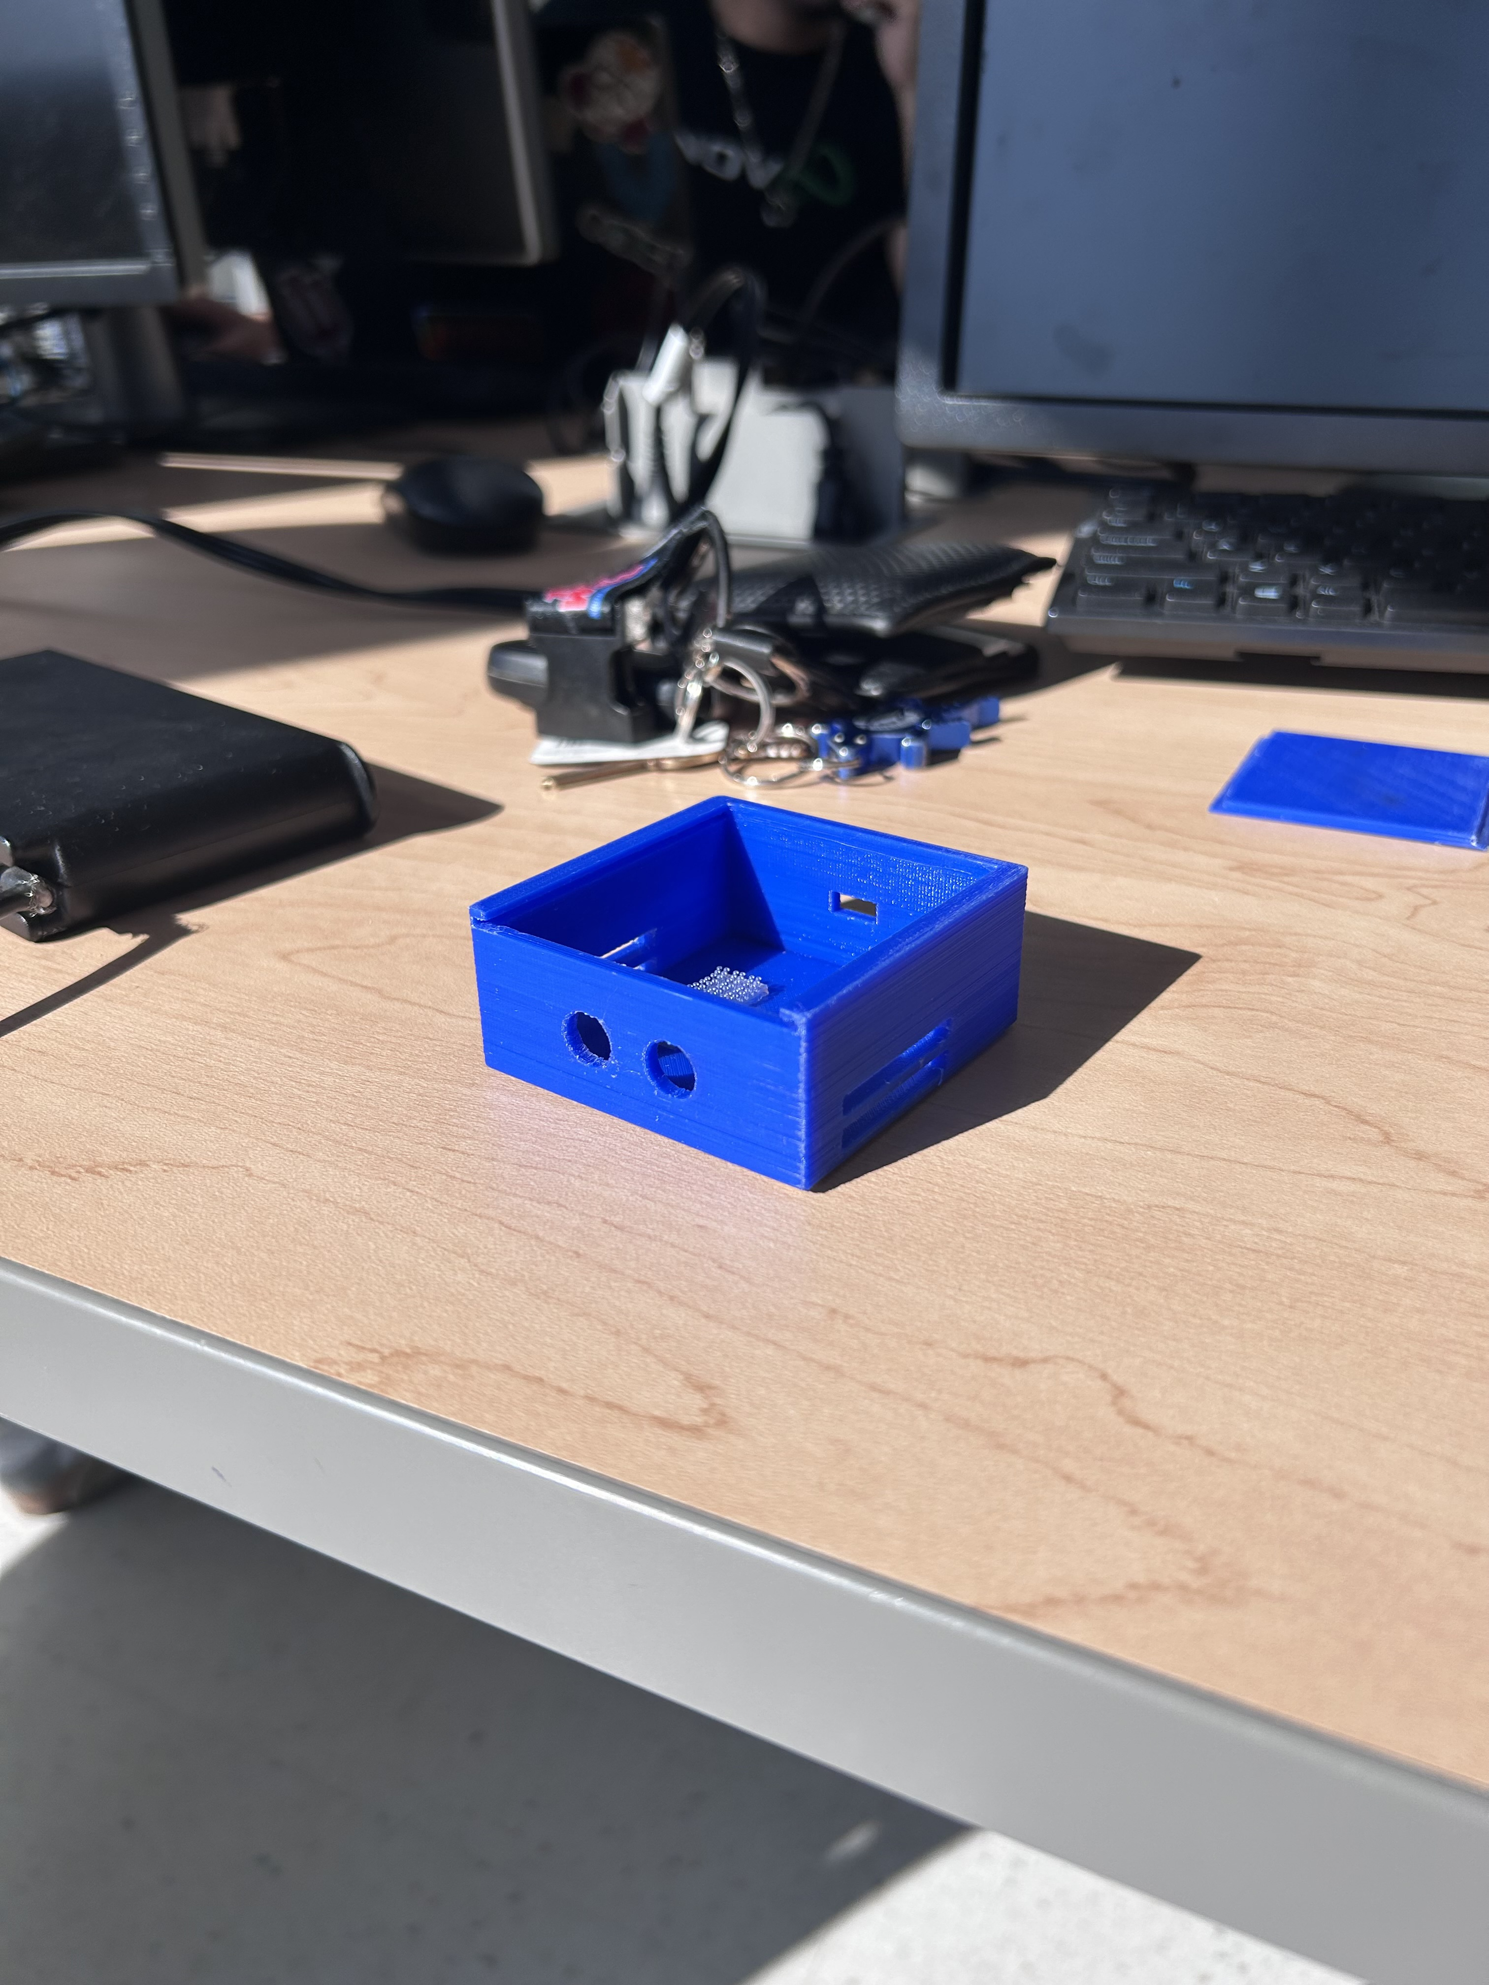
AJ
Prototype Design – Wearable
41
Notes:
AJ

Slide 42
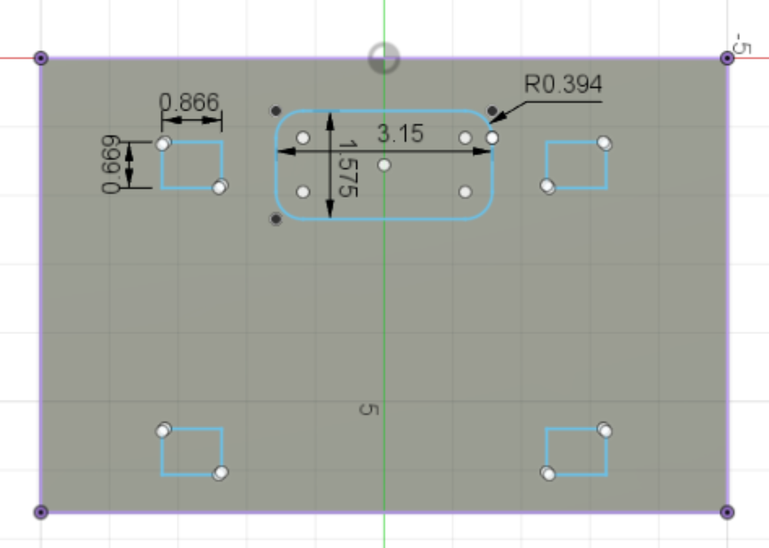
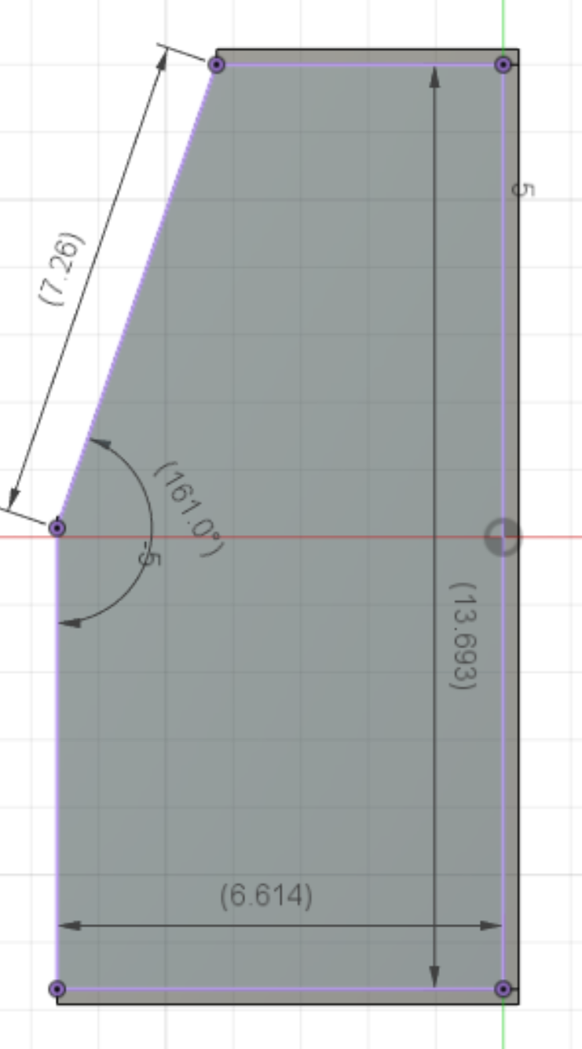
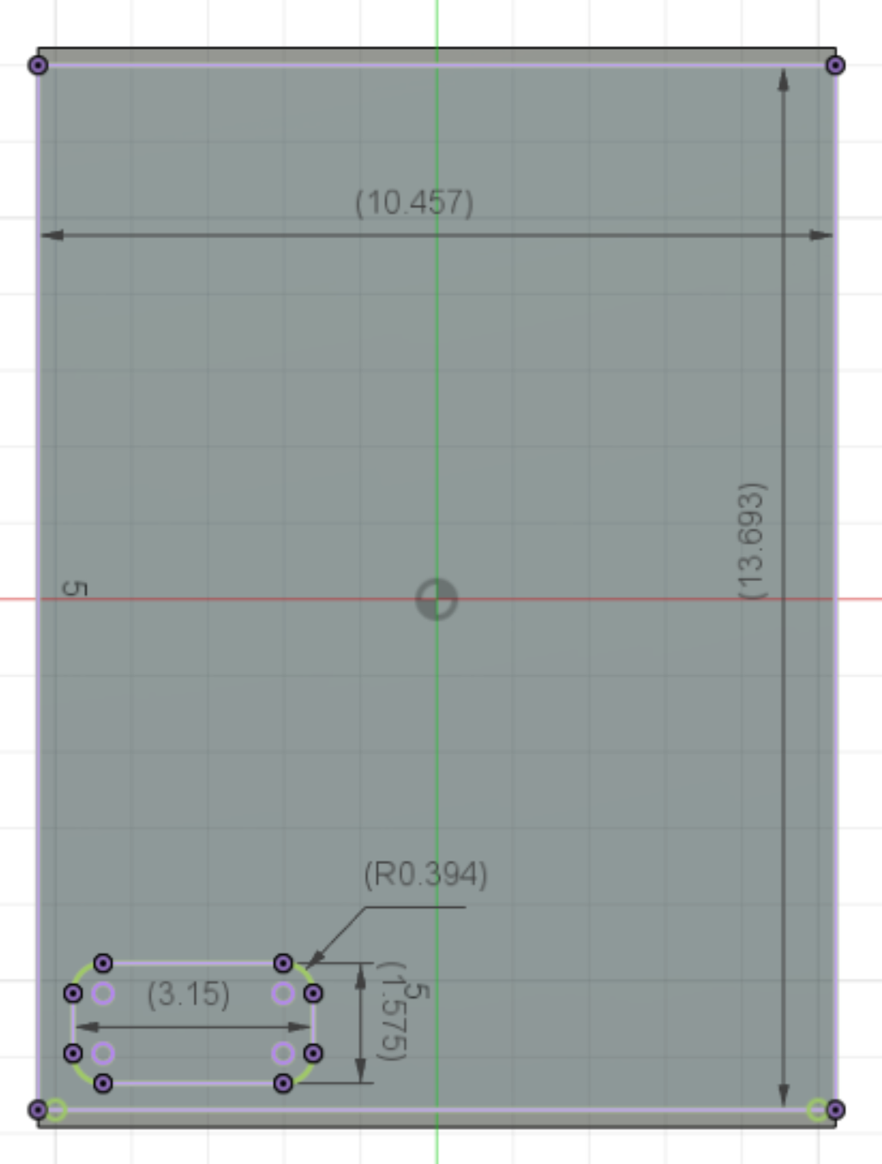
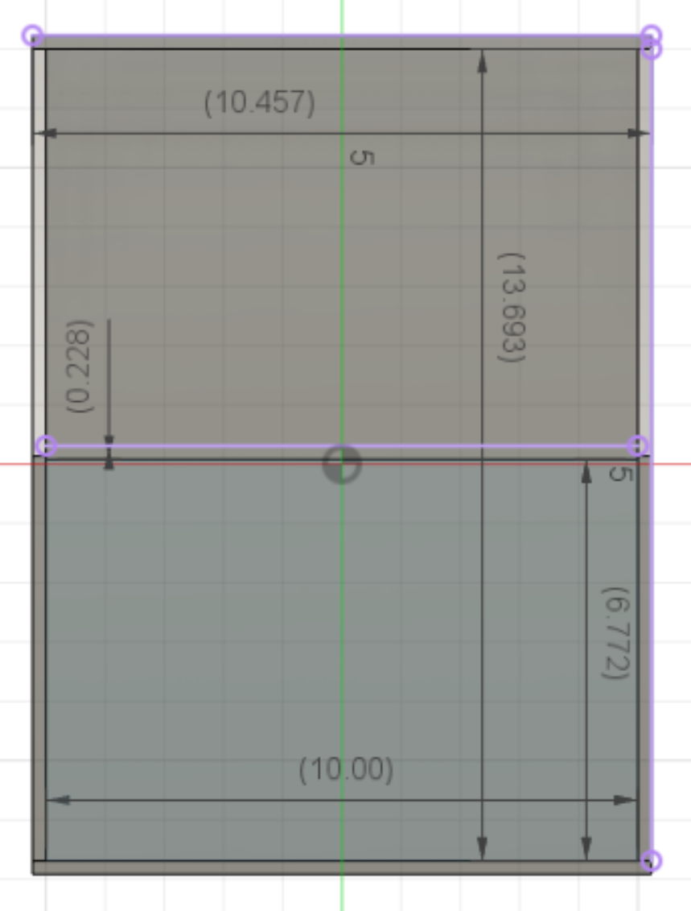
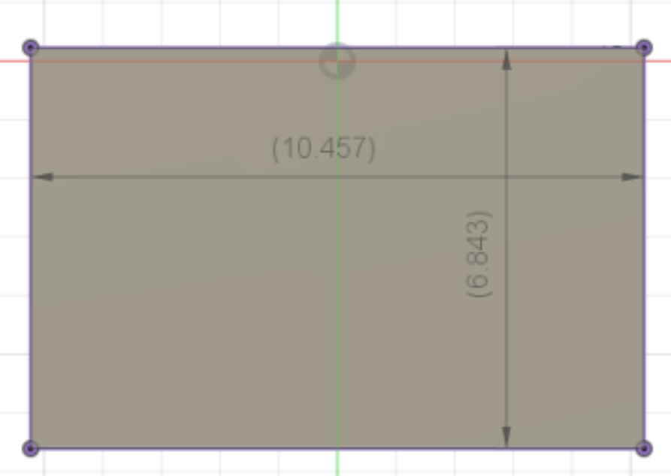
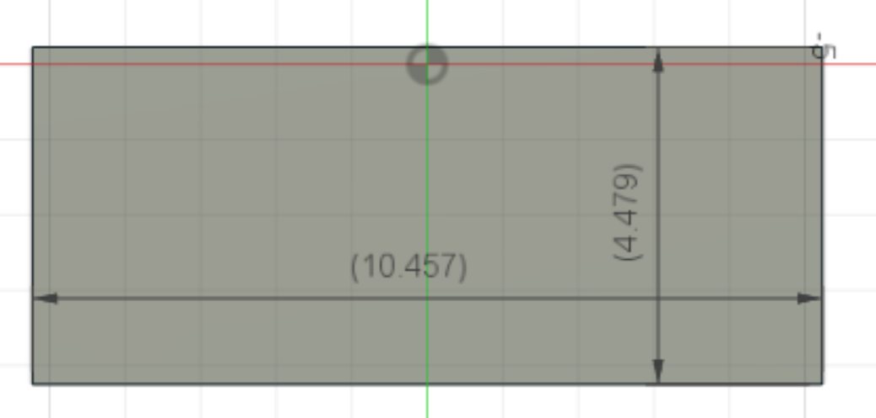
AJ
Prototype Design – Box
42
Notes:
AJ

Slide 43
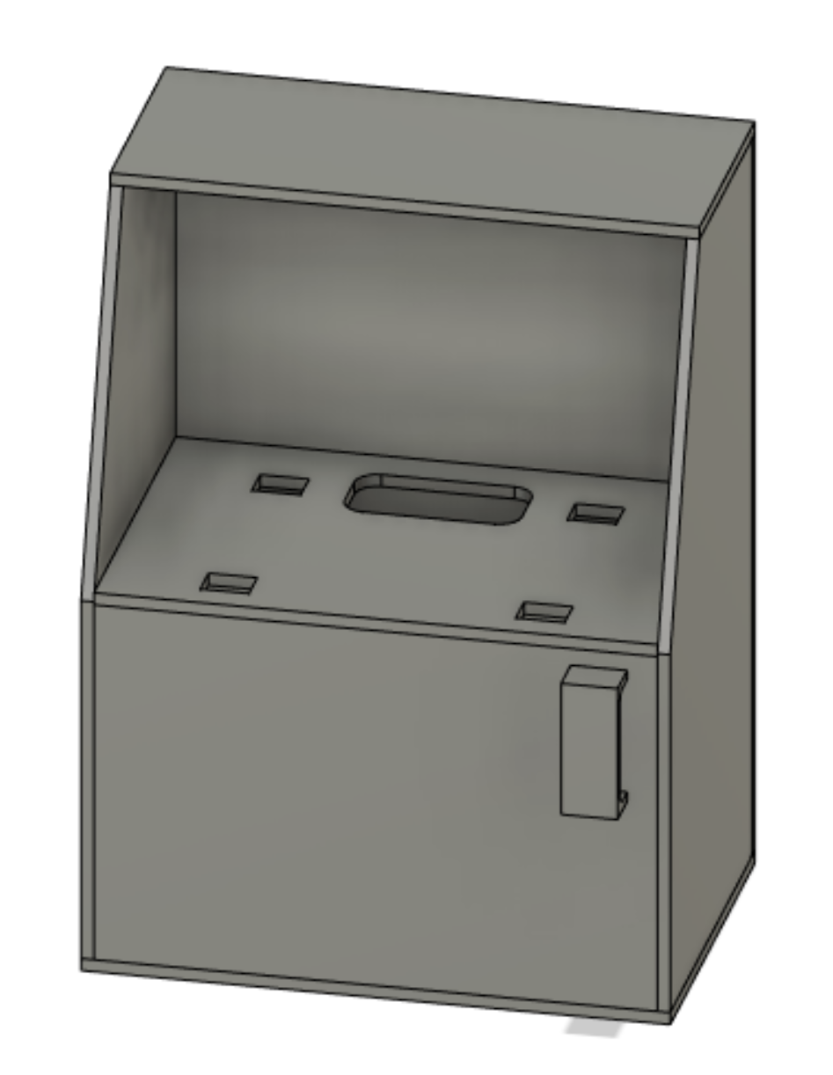
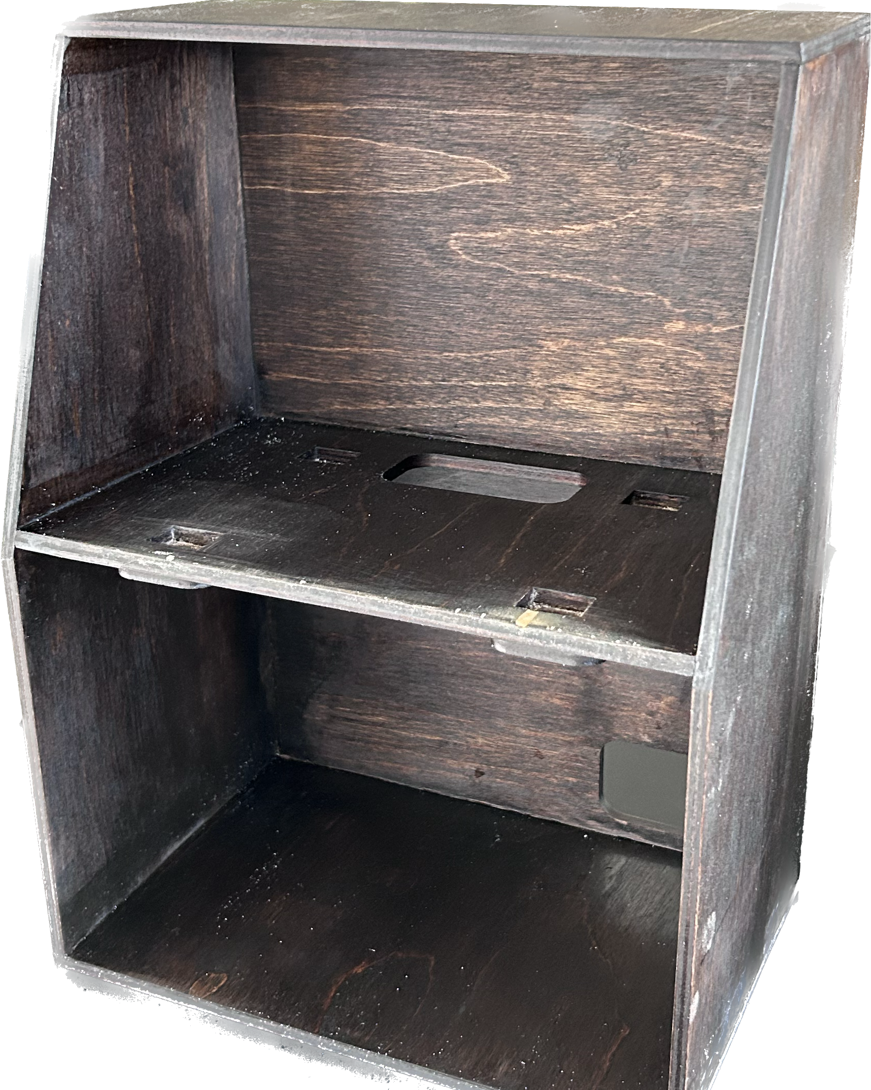
AJ
Prototype Design – Box
43
Notes:
AJ

Slide 44
System Demonstration
SECTION 6
44
Notes:
Ryan

Slide 45
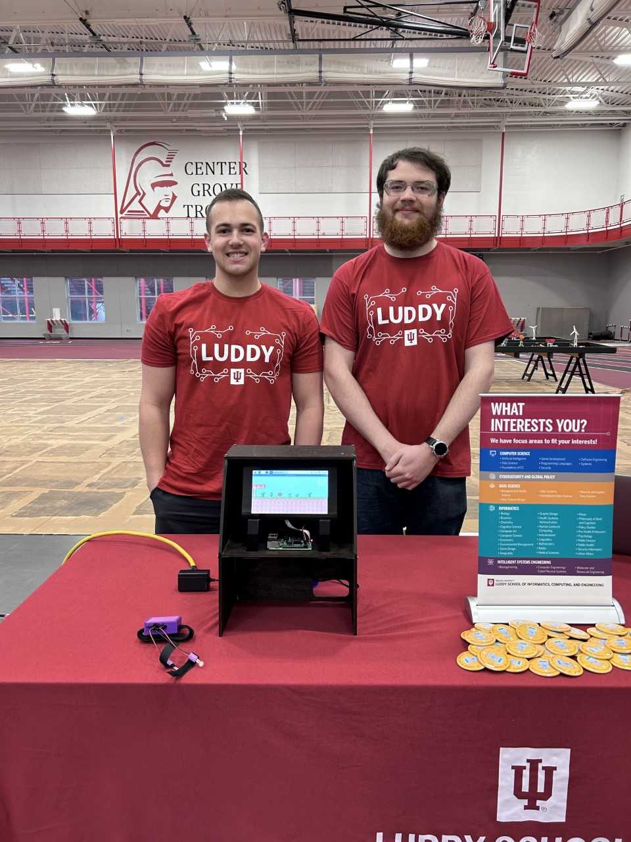
FIRST Robotics Demo
Event Debut
FIRST Robotics Event March 31st
Received great feedback
45
Notes:
Ryan/AJ

Slide 46
Live Demo
Power on the device
Run either Easy_start or Normal_start
These relate to the level difficulty
Turn on the wearable by flipping the switch
46
Notes:
All show off

Slide 47
Sustainability
SECTION 7
47
Notes:
Isaac

Slide 48
Sustainability
Alkaline battery will need to be replaced after 16 hours of use
Batteries can be recycled by Luddy battery disposal bucket, per EPA standards
All our parts are from reputable vendors like DigiKey, Adafruit and Arduino
Easy to replace the force transducers
Arduino microcontroller can be easily overwritten if needed
Well documented
48
Notes:
Isaac

Slide 49
Lifelong Learning Objectives
SECTION 8
49
Notes:
Ben

Slide 50
Lifelong Learning Objectives
We learned a lot about project planning, constraints, project management, game design, and research processes.
Able to collect senor reading from a microcontroller's datasheet to find relevant peripherals
Became familiar with debugging, circuit design, and fabrication
Obtained experience with integrating a Bluetooth network between hardware interfaces.
50
Notes:
Ben

Slide 51
Next Steps
Lithium-ion battery
Latency
Arduino
Bluetooth
Raspberry Pi
Interface with new demonstration
Drone
Differential drive robot
Printed Circuit Board
51
Notes:
AJ

Slide 52
Questions?
52
Notes:
All

